Slide 1
ECAP: Best Practices for Implementation
Arizona College Access Network
Arizona Department of Education

Slide 2
Your School Counselor Specialist
Stapley Junior High
6 years
English Teacher
Millennium High School
3 years
School Counselor
Agua Fria High School
8 years
School Counselor & Department Chair
Phoenix Union High School District
3 years
Counselor Facilitator
Arizona Department of Education
1.5 years
School Counselor Specialist
Associations
ACTEAZ
AzCTE Leads
AzSCA
Goals
Education & Advocacy
Comprehensive School Counseling Programs
Relationships

Slide 3
Objectives
Review ECAP Board Rule, Attributes, & Compliance
Understand what ECAP should and should NOT be
Learn how to embed ECAP requirements into school counseling programs
See examples of ECAP Action Plans
See examples of ECAP Lesson Plans
Leave with resources to assist in ECAP implementation

Slide 4
ECAP Board Rule
ECAP requirements as outlined in Board Rule R7-2-302.05
(Approved February 25, 2008):
Academic Goals
Career Goals
Postsecondary Education Goals
Extracurricular Goals

Slide 5
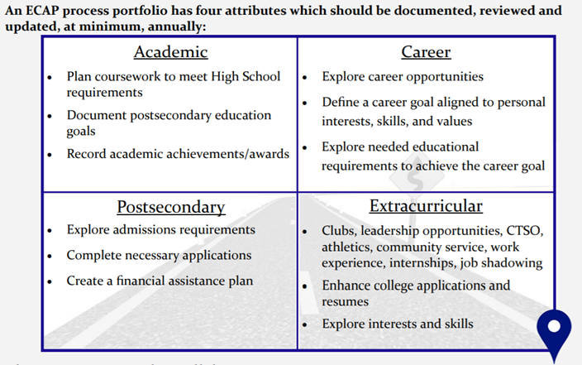
ECAP – Four Attributes
\

Slide 6
ECAP At-a-Glance
Should Be
Student Centered
Engaging
Should NOT Be
Checklists
Assessments without discussion
Solely Computer Centered
Conversations

Slide 7
School Counseling Domains
Academic
Achievement
Domains
Career
Social/Emotional
Development

Slide 8
Compliance
Each year ADE requests schools to submit two ECAP documents:
A copy of the school-wide implementation action plan or calendar (action plan or calendars should include: What, Where, When, Who in order to present a clear picture of you ECAP process for ALL students
A copy of a completed ECAP from one student from the graduating class with all identifying student information removed in order to be FERPA complaint

Slide 9
ECAP – True/False
Requirements have not changed since 2008
It takes too much time
It must be completed with students individually
ECAP data can be used to support my school counseling program
School counselor must be the one to document
All parts of the chosen platform must be completed – For example – everything must be completed from the grade level check lists in AzCIS
You can mix paper and electronic documentation
ECAP must look “pretty” for submission
Students must back track if they transferred to you without an ECAP
ECAP is an ongoing process – not a one and done
TRUE
FALSE
FALSE
TRUE
FALSE
FALSE
TRUE
FALSE
FALSE
TRUE
Talk to me. What have I missed? Drop your thoughts in the chat.

Slide 10
Scope and Sequence
Start with what you are already doing
List every activity, event, lesson, etc. for each grade level
List the delivery method (classroom lesson, field trip, online, Advisory, teacher delivery, lunch time, parent communication, website, etc.)
Match the activity, event, lesson, etc. to the four ECAP attributes
Cross walk with ASCA standards
Make it manageable and sustainable
This scope and sequence becomes the Action Plan

Slide 11
Flagstaff High School
https://www.fusd1.org/Page/18421

Slide 12
Flagstaff High School
https://www.fusd1.org/Page/18421

Slide 13
Flagstaff High School
https://www.fusd1.org/Page/18421

Slide 14
Flagstaff High School
https://www.fusd1.org/Page/18421

Slide 15
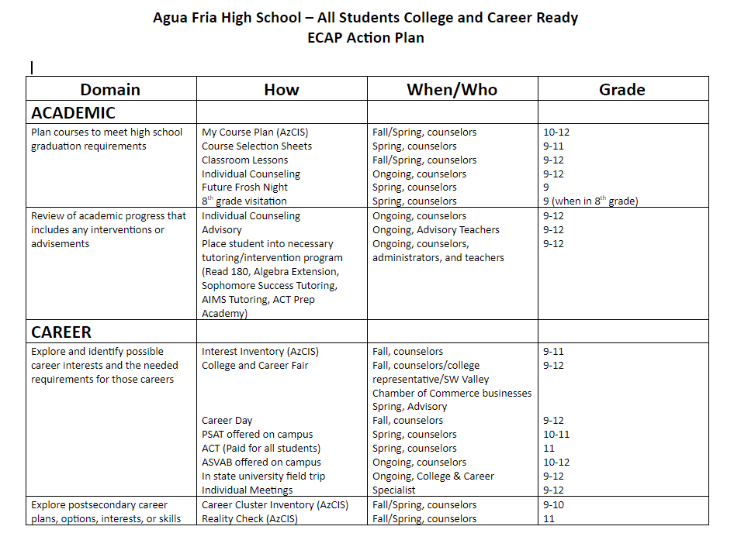
Action Plan Examples
ECAP Attribute
Board Rule Language

Slide 16
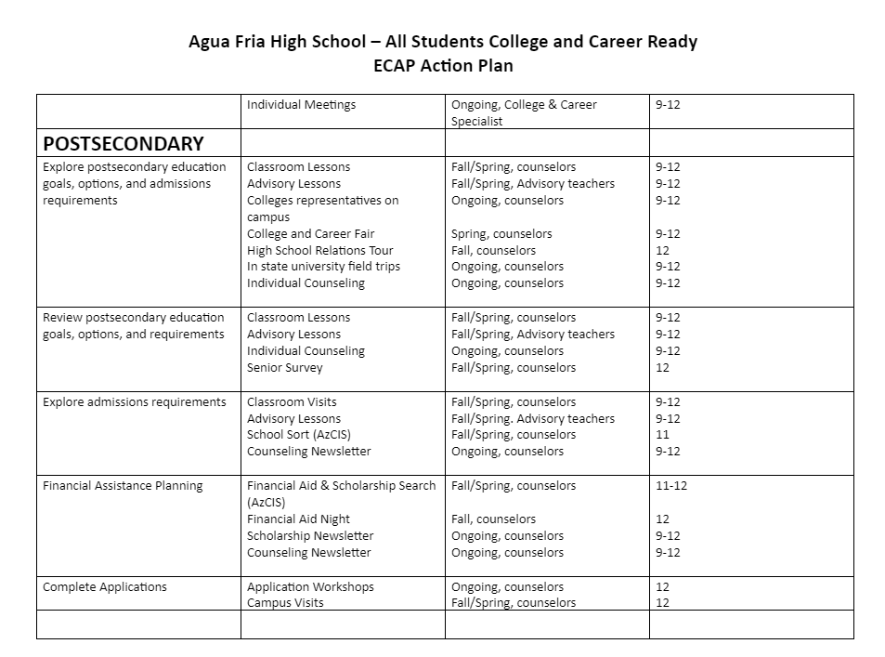
Action Plan Examples

Slide 17
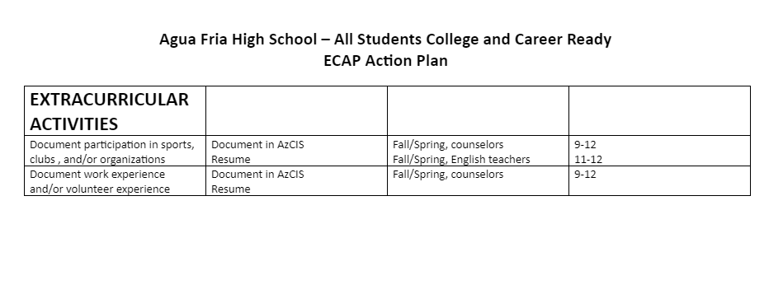
Action Plan Examples

Slide 18
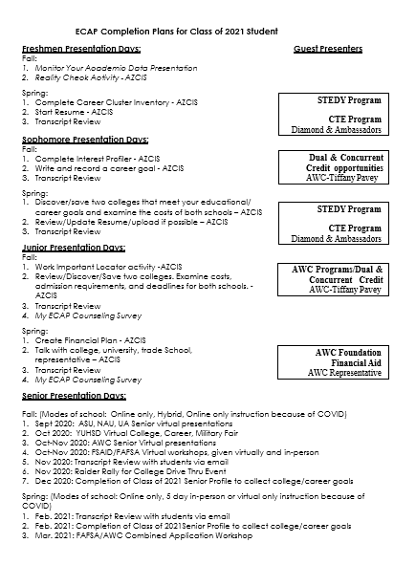
Action Plan Examples

Slide 19
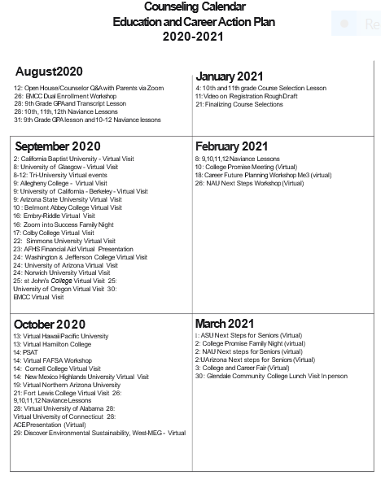
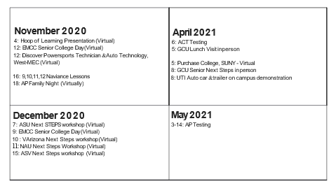
Action Plan Examples

Slide 20
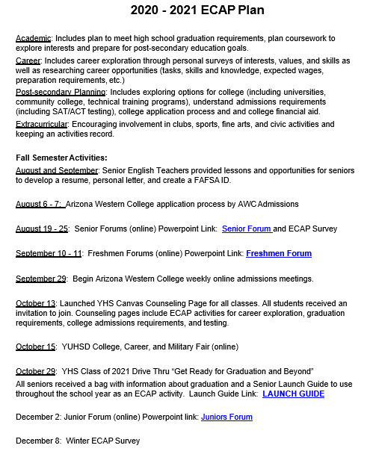
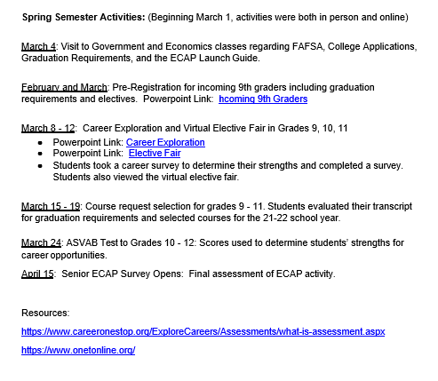
Action Plan Examples

Slide 21
ECAP Student Sample
Can be anything that showcases the four ECAP attributes
Can have more on it than just the four attributes but not required
Can be the summary print out if you are using a platform
Can be a document created by you
Can be electronic or paper or a mixture
Can be messy
Should be student driven
Should show what has been added/updated for each year
Student should always have access to the document – can be difficult with paper

Slide 22
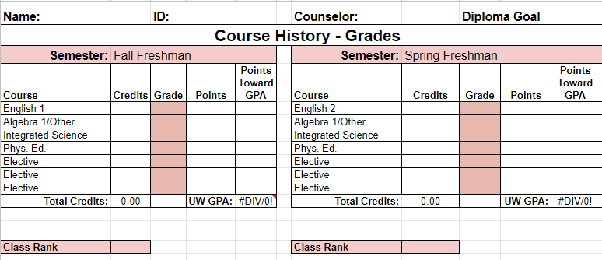
ECAP Student Sample
Electronic ECAP - Google SHEETS – Glendale Union High School

Slide 23
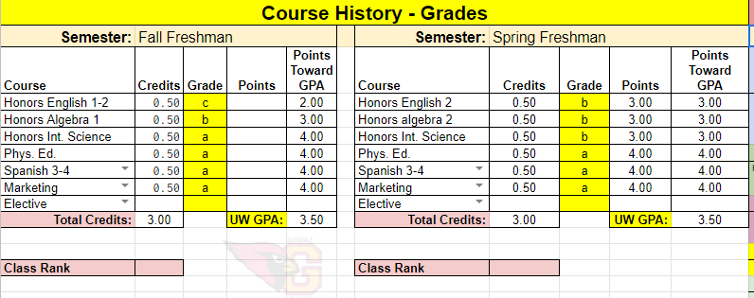
ECAP Student Sample

Slide 24
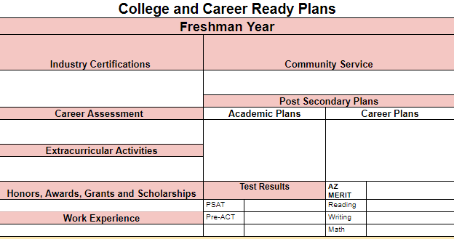
ECAP Student Sample

Slide 25
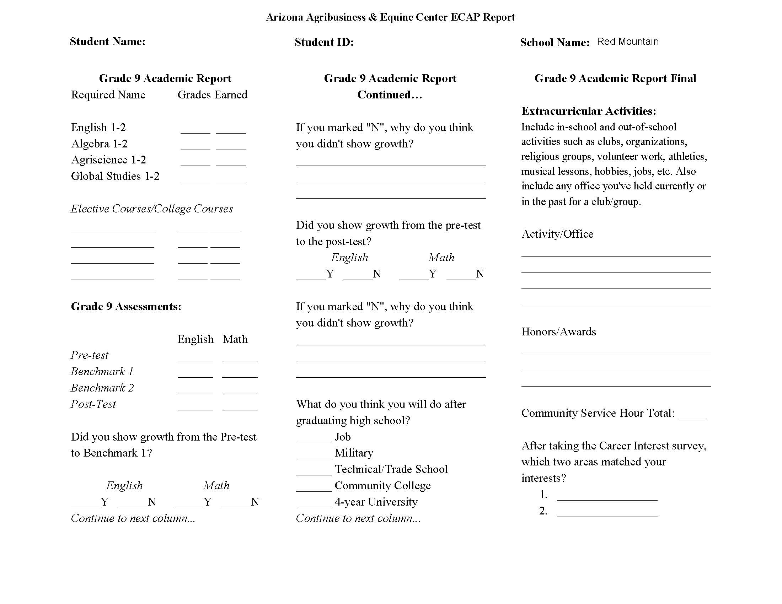
ECAP Student Sample

Slide 26
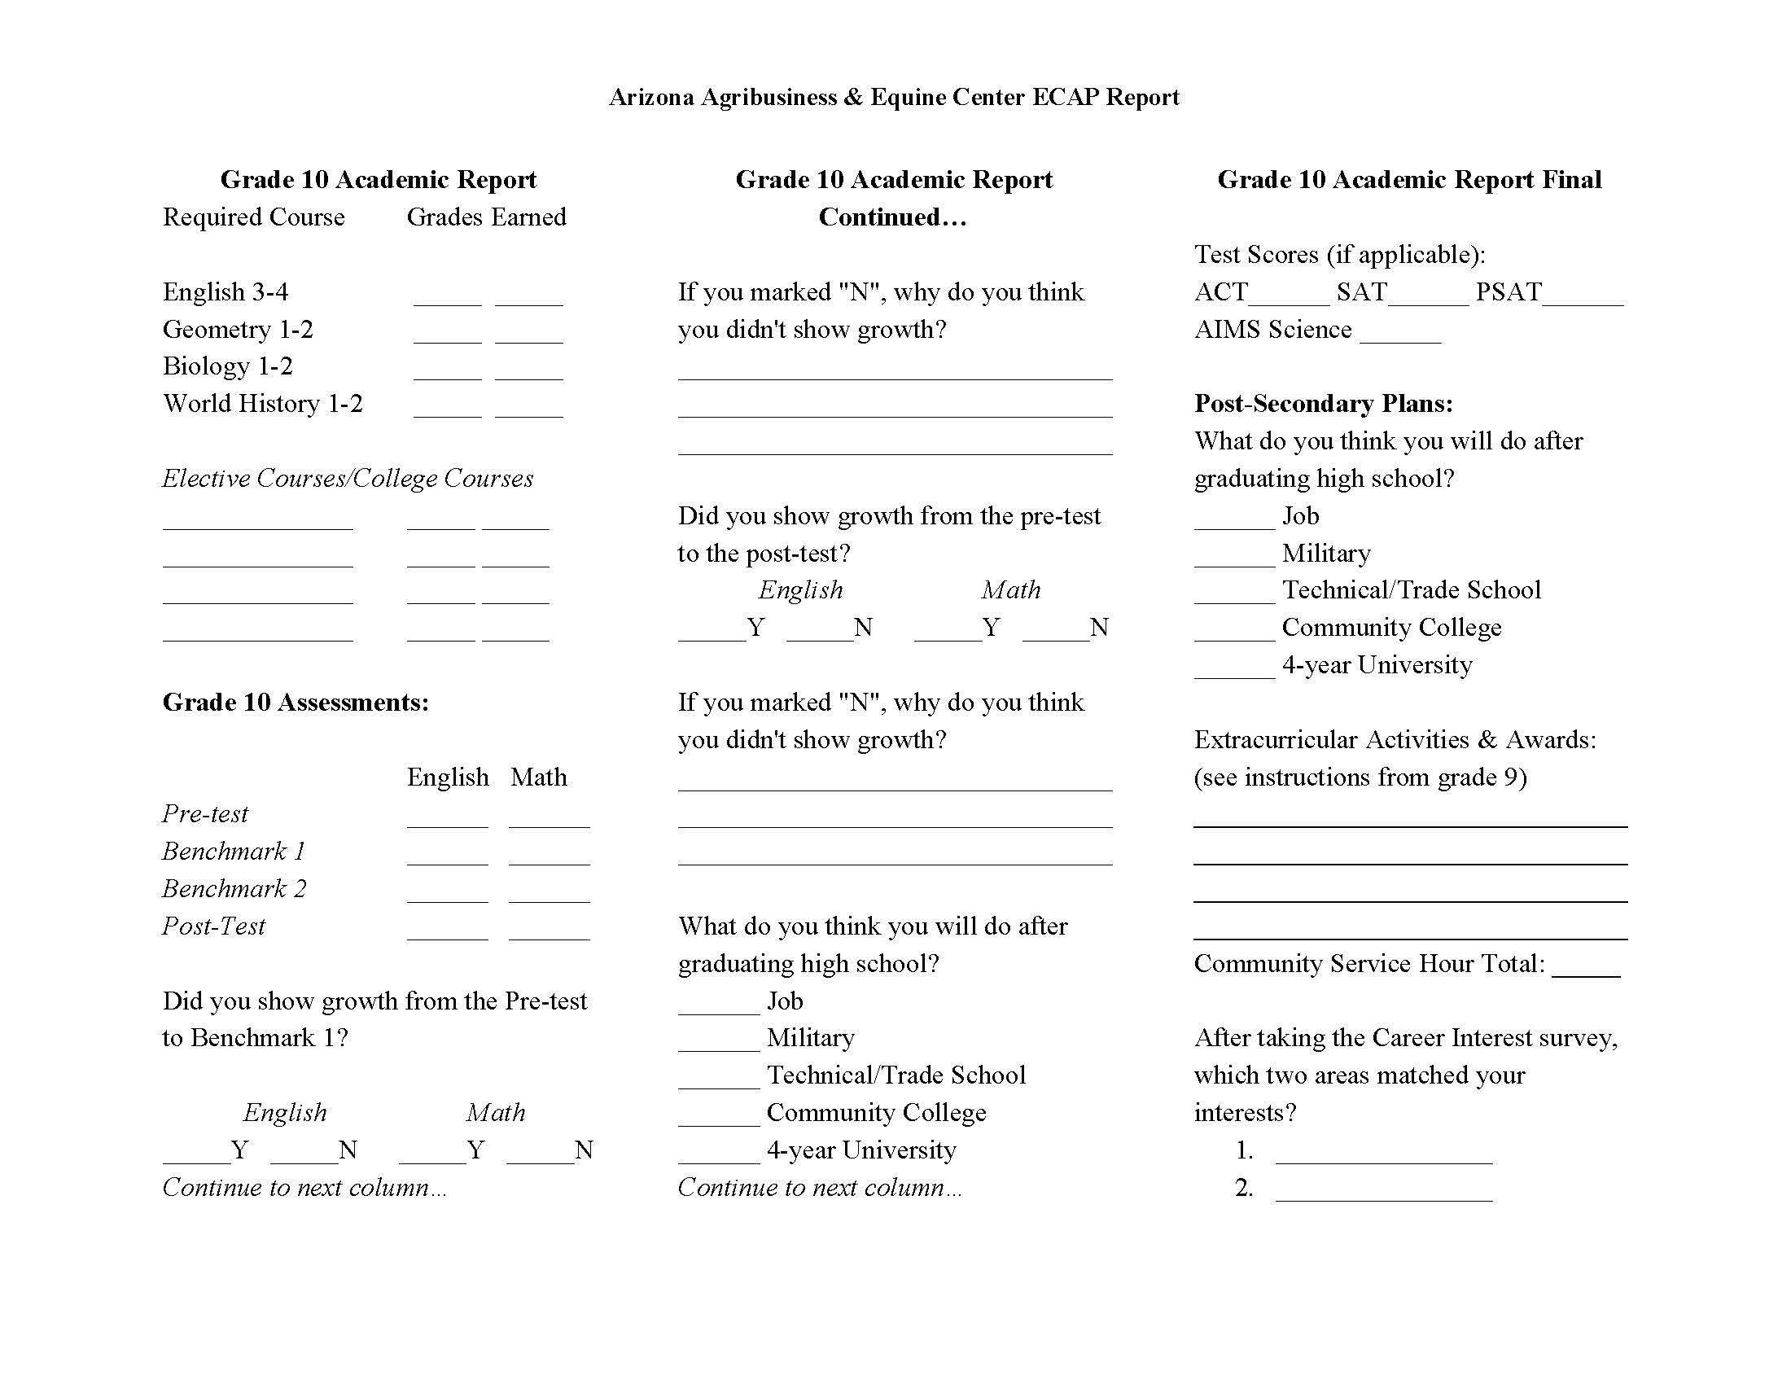
ECAP Student Sample

Slide 27
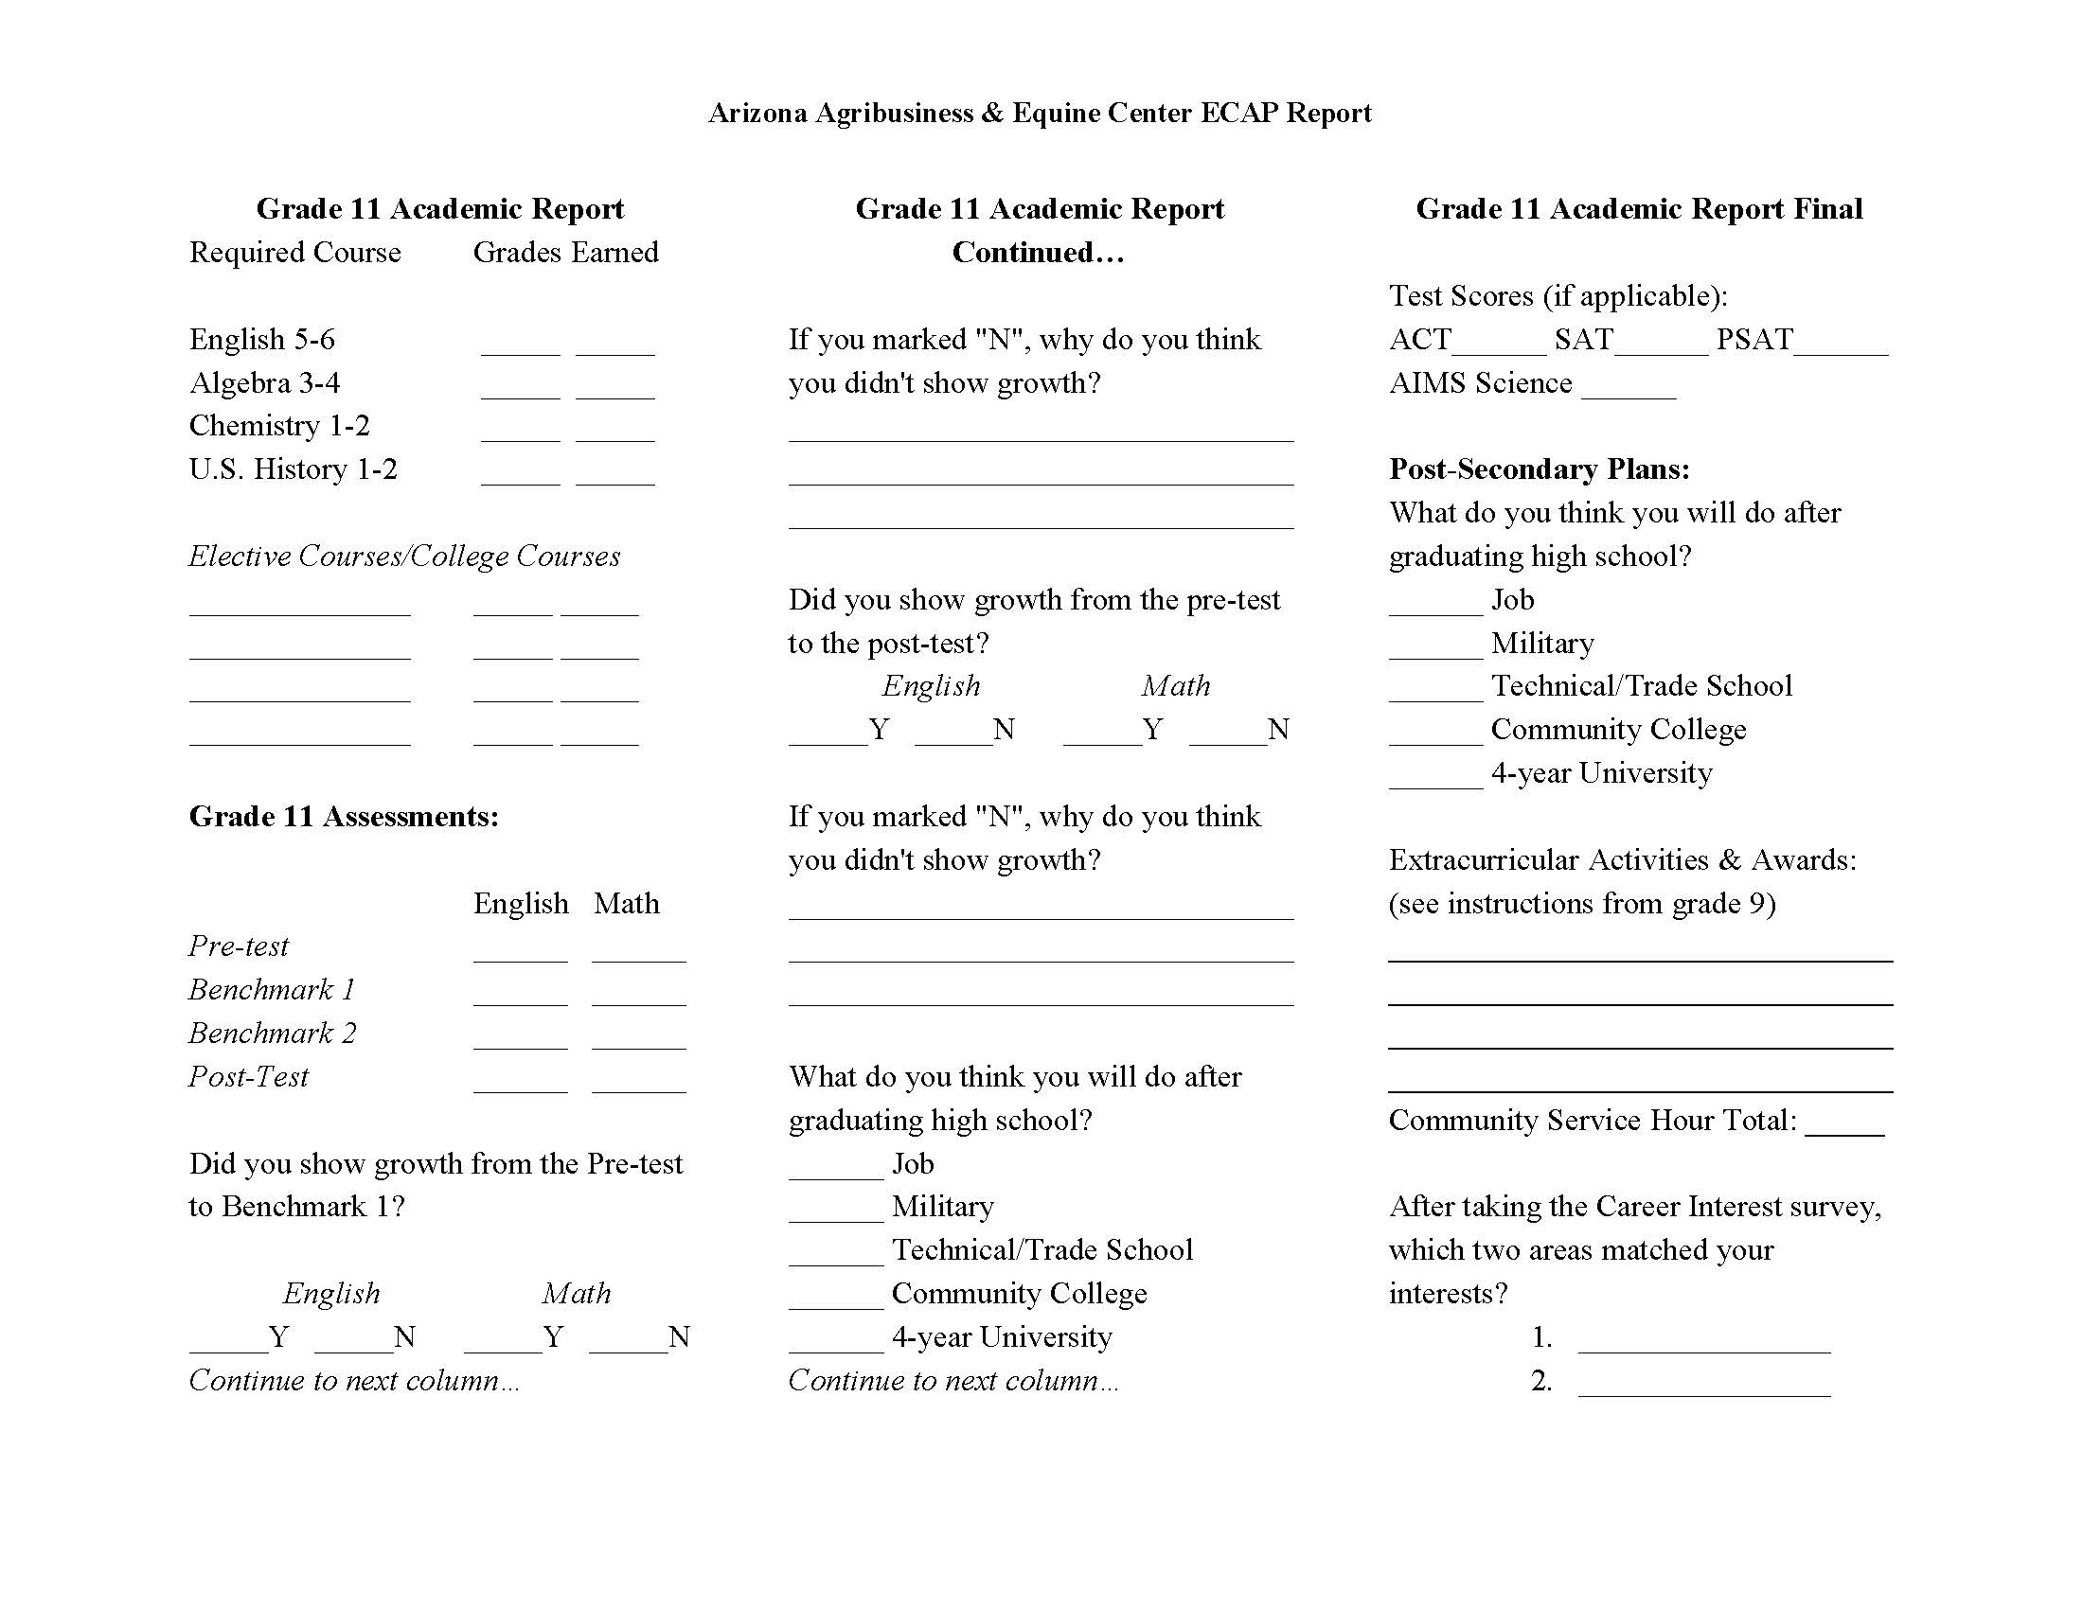
ECAP Student Sample

Slide 28
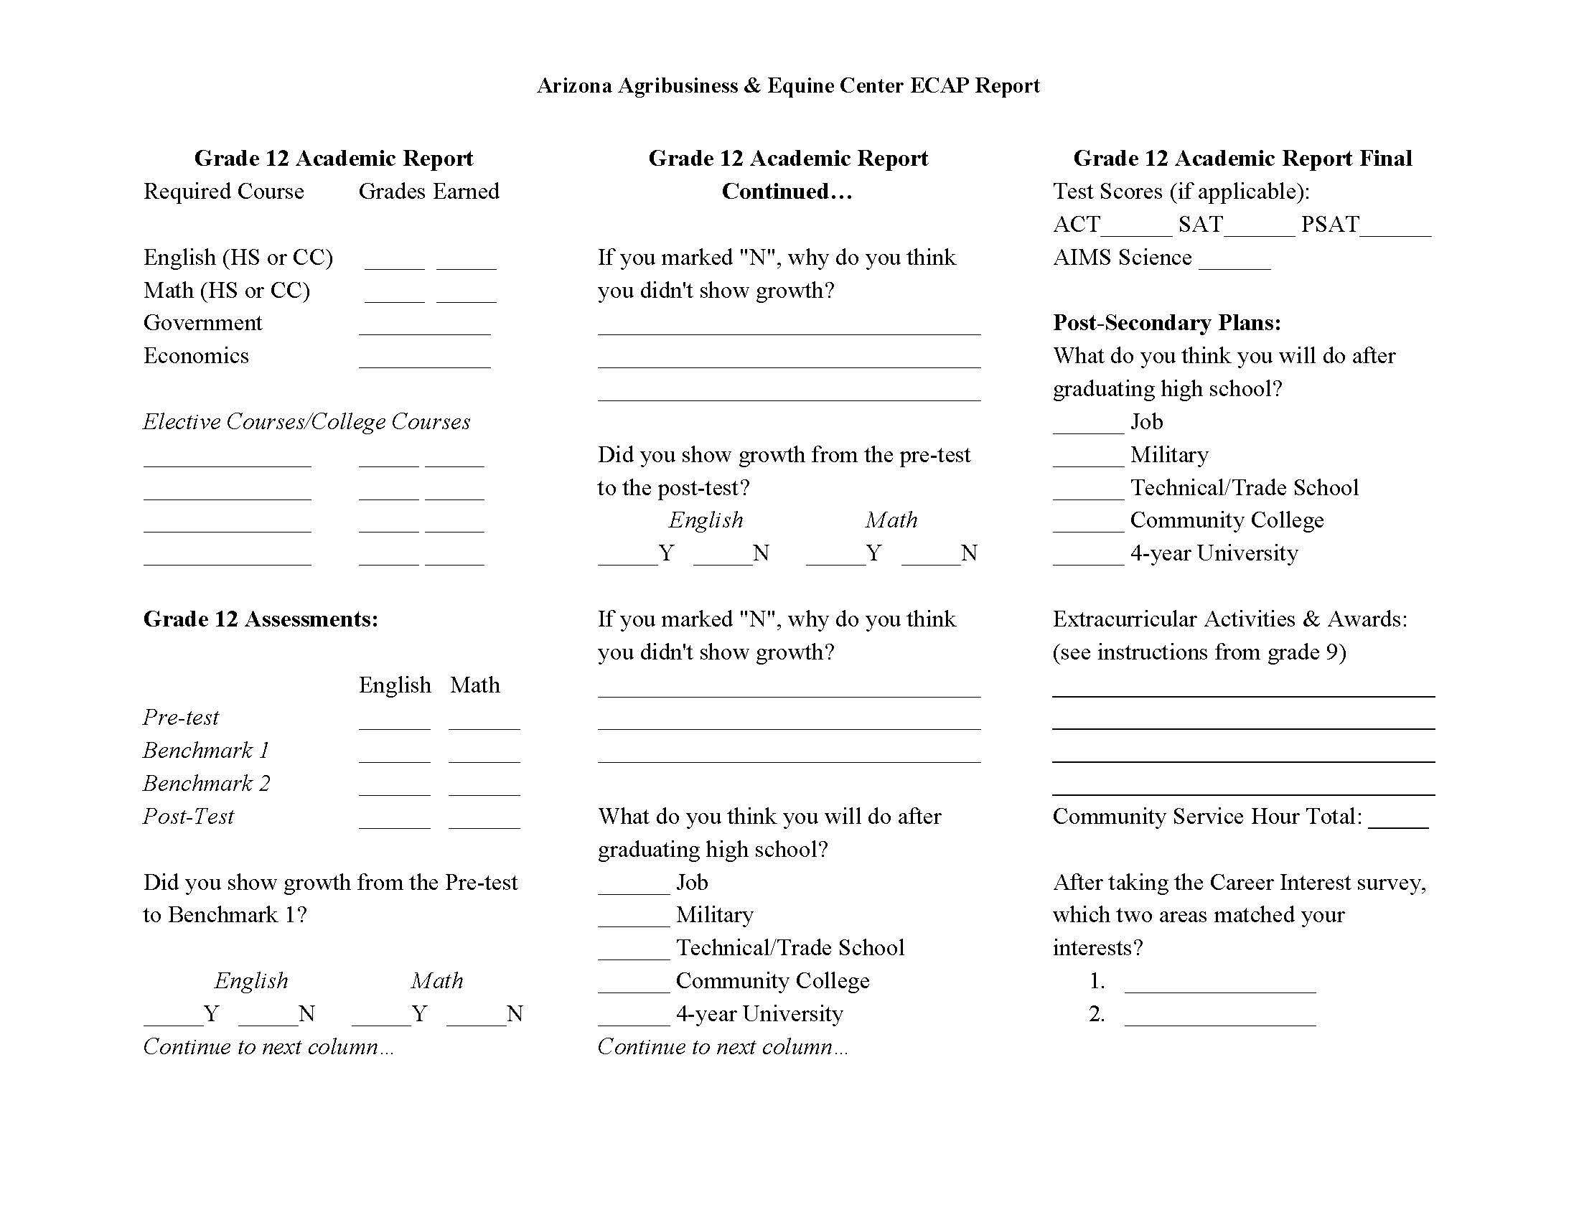
ECAP Student Sample

Slide 29
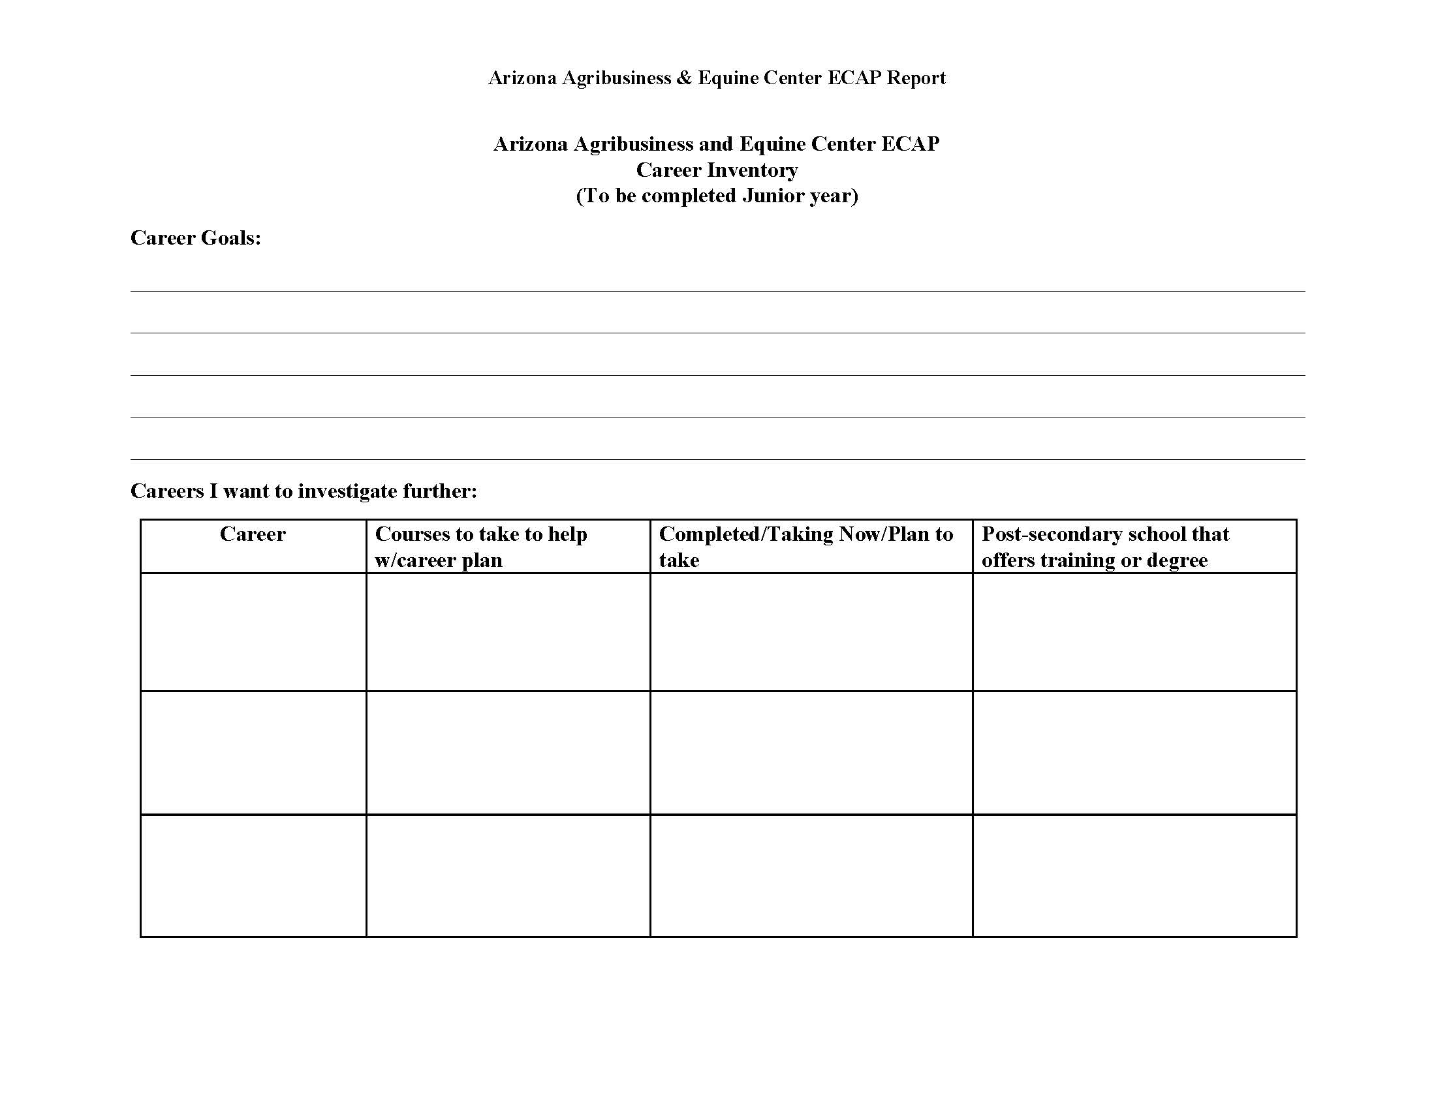
ECAP Student Sample

Slide 30
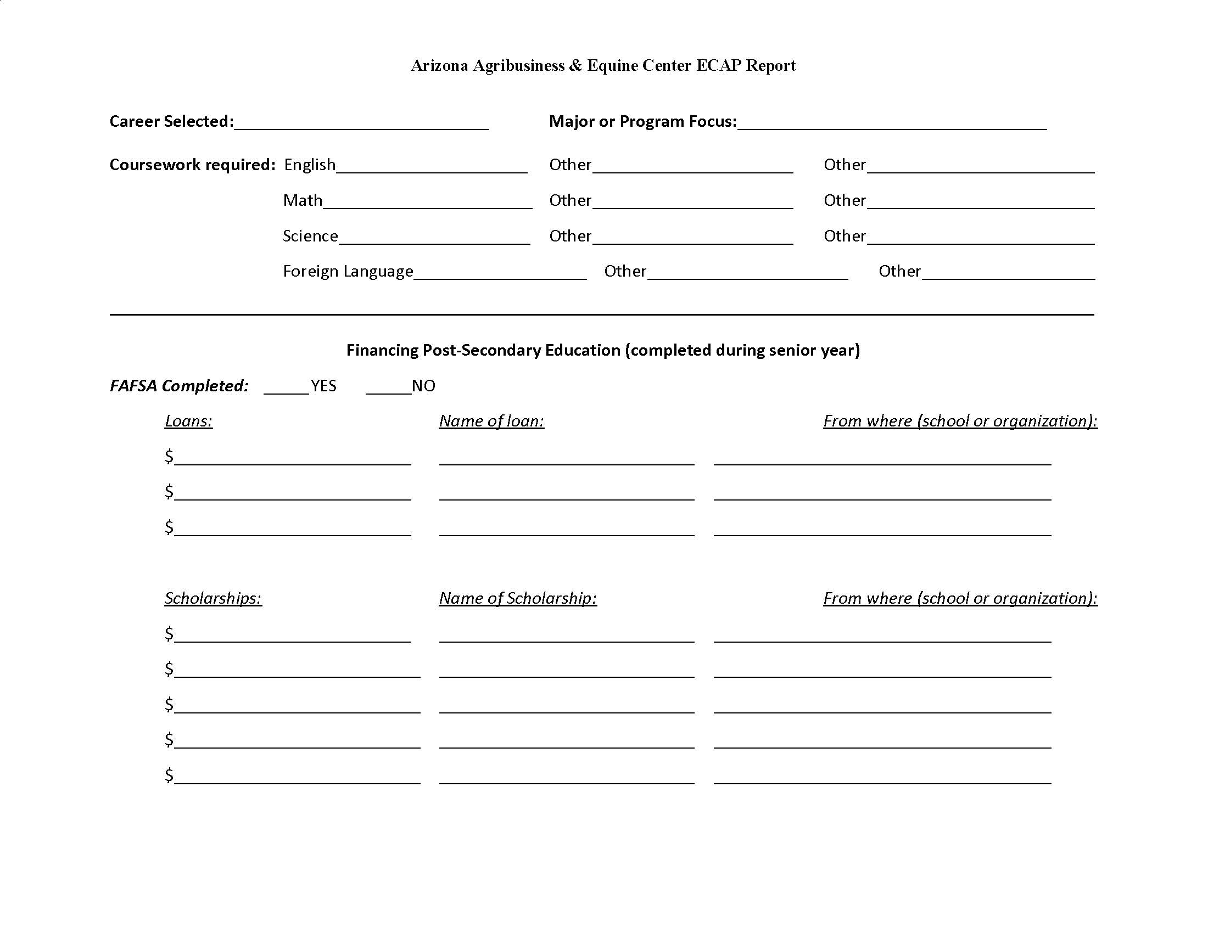
ECAP Student Sample

Slide 31
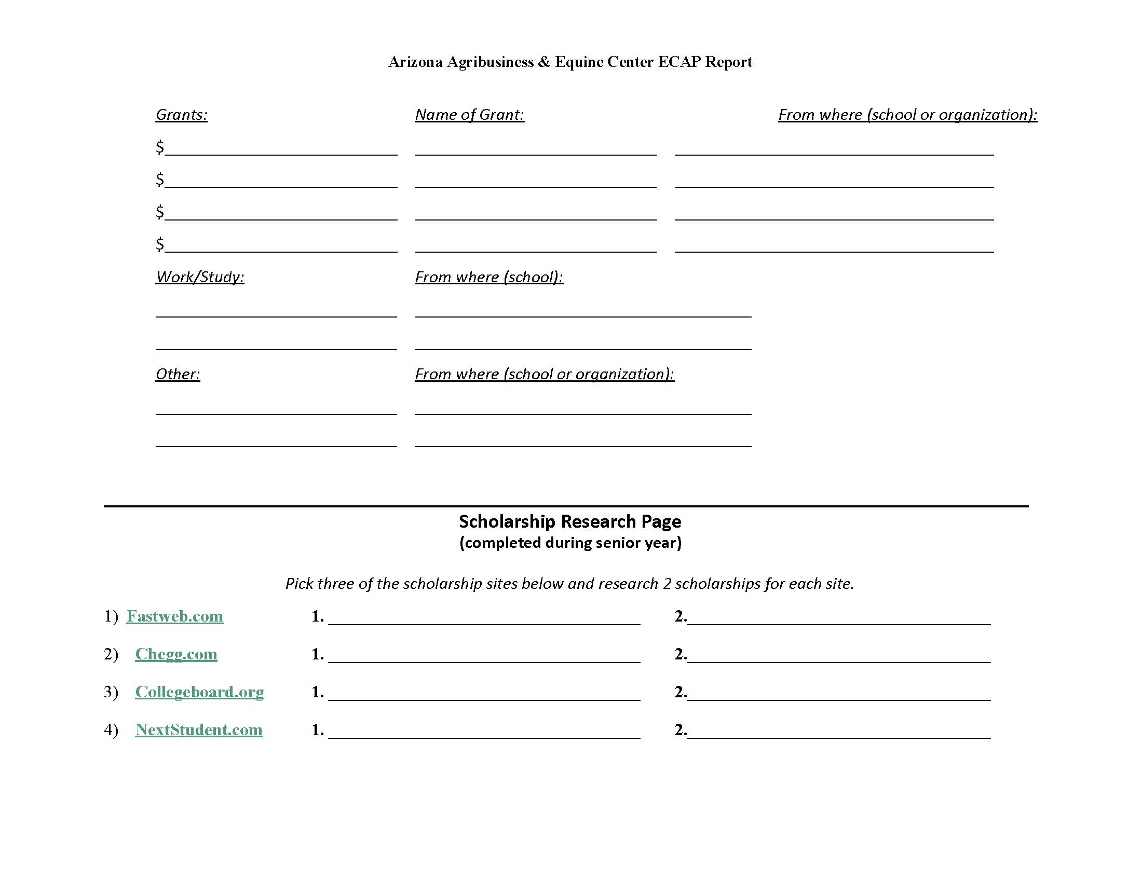
ECAP Student Sample

Slide 32
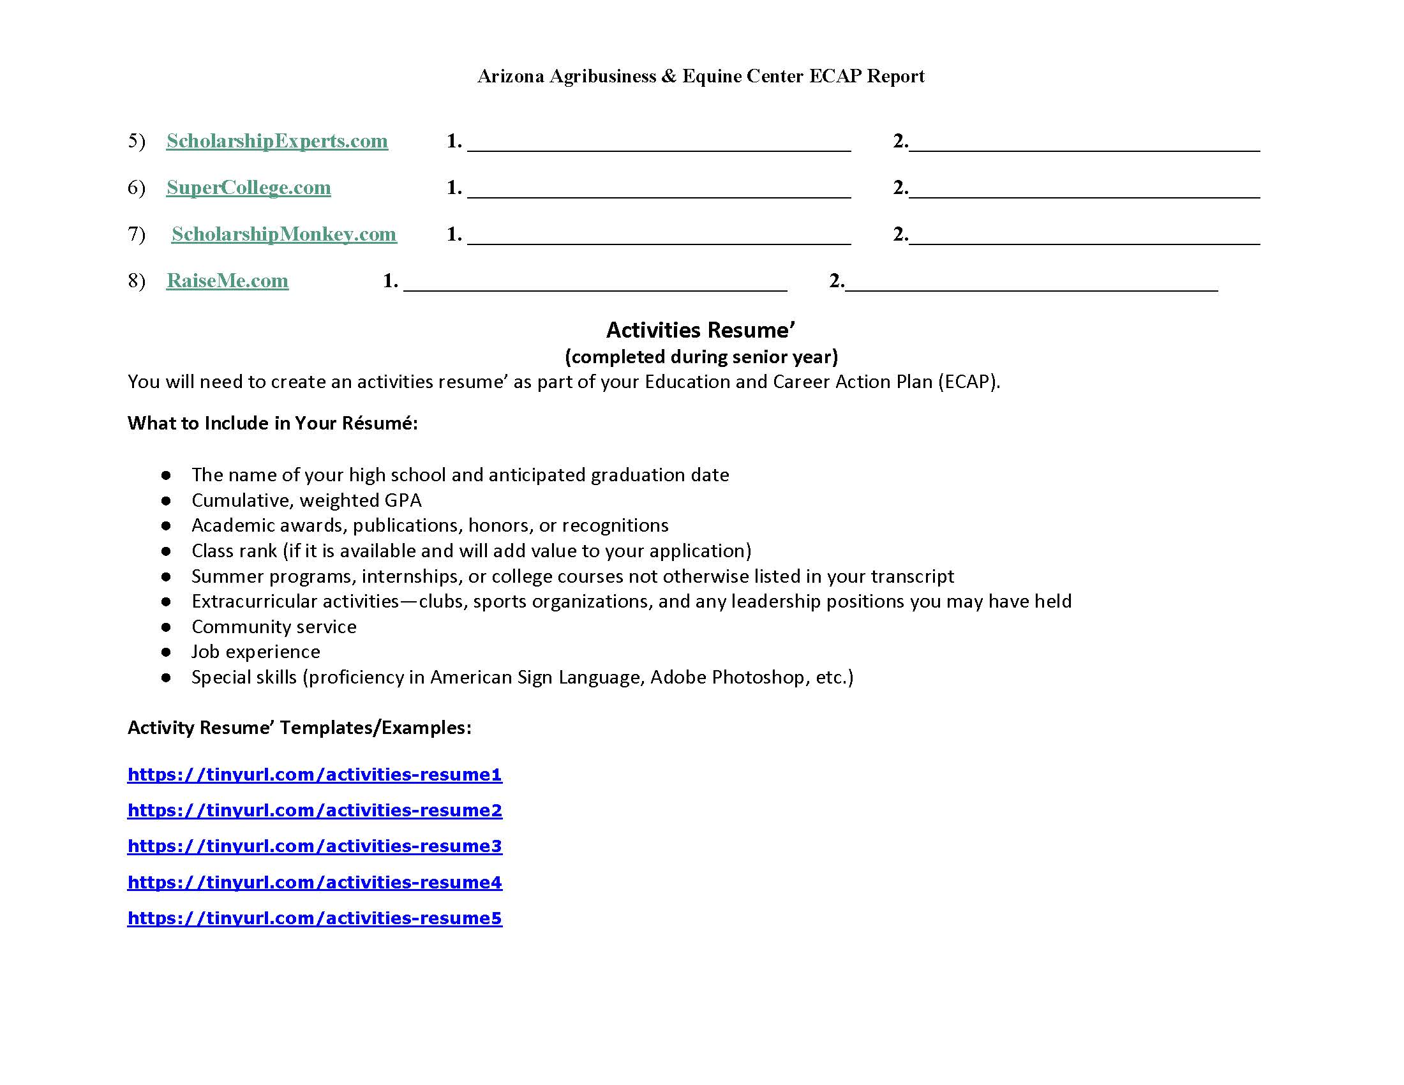
ECAP Student Sample

Slide 33
Let’s Discuss
What changes, if any, do you think you will make to your ECAP documentation based upon these examples?
https://tinyurl.com/ECAPBP

Slide 34
ECAP Resources
Check out the ADE ECAP page at www.azed.gov/ecap
ADE School Counseling Padlet
(Multiple resources for school counselling including ECAP support)
ECAP Implementation
(Includes communication tools, toolkits, self assessments, more examples and samples)
K-8 Career Literacy
(ADE site designed to support K-8 career literacy)

Slide 35
My Future AZ
New career exploration and ECAP platform from ADE now available.
www.azed.gov/ecap

Slide 36
Contact Information
Amanda Nolasco
School Counselor Specialist
amanda.nolasco@azed.gov
www.azed.gov/cte/counselors
@mrs_anolasco
Amanda Nolasco
School Counselor Connection - Click to get the newsletter or update your information

