Slide 1
Arizona’s Career Literacy Standards (K-8)
Amanda Nolasco
School Counselor Specialist
Arizona Department of Education

Slide 2
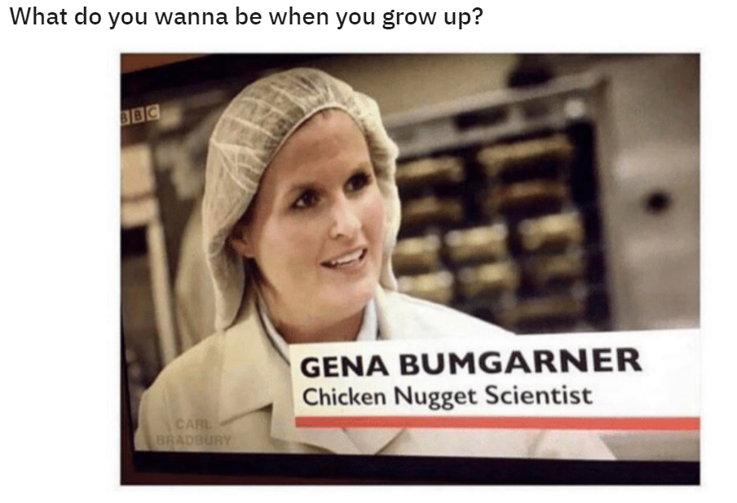

Slide 3
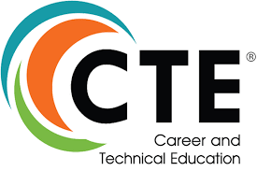
Arizona Career Literacy
Career Literacy allows students to explore their passions and translate those passions into viable careers. It exposes students to a wide variety of careers, including those they may never have heard of. Career Literacy provides a pathway for students to create long-term goals as they make their way toward graduation and beyond
.

Slide 4
Arizona Career Literacy Standards
Career Awareness
K-4
Career Exploration
5-8
Career Development & Preparation
9-12
The Arizona Career Literacy Standards focus on K-8
Arizona Professional Skills focus on 9-12

Slide 5
K-2 Career Literacy
K-2-Career-Literacy-Standards.pdf (azed.gov)

Slide 6
K-2 Career Literacy
1.0 Critical Thinking and Problem Solving
2.O Collaboration, Teamwork, and Leadership
3.0 Cross- Cultural Understanding and Interpersonal
Communication
4.0 Communication and Media Fluency
5.0 Accountability, Productivity, and Ethics

Slide 7
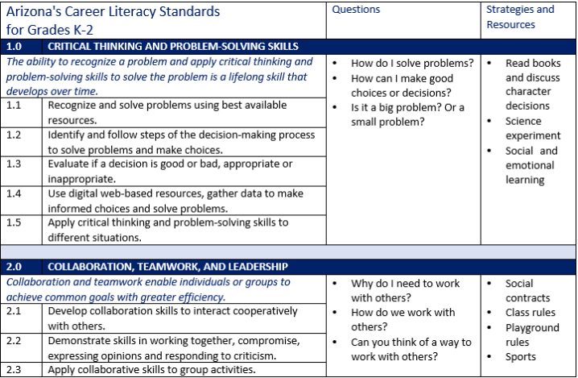
K-2 Career Literacy

Slide 8
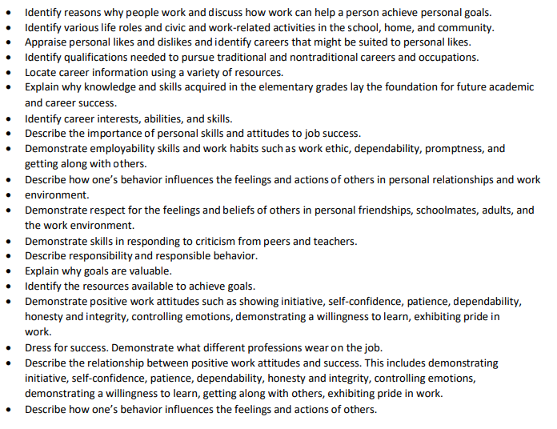
Strategies K-2

Slide 9
2-4 Career Literacy
2-4-Career-Literacy-Standards.pdf (azed.gov)

Slide 10
2-4 Career Literacy
1.0 Critical Thinking and Problem Solving
2.O Creativity and Innovation
3.0 Collaboration, Teamwork, and Leadership
4.0 Cross- Cultural Understanding and Interpersonal
Communication
5.0 Communication and Media Fluency
6.0 Accountability, Productivity, and Ethics
7.0 Describe the Fundamental Principles of Money

Slide 11
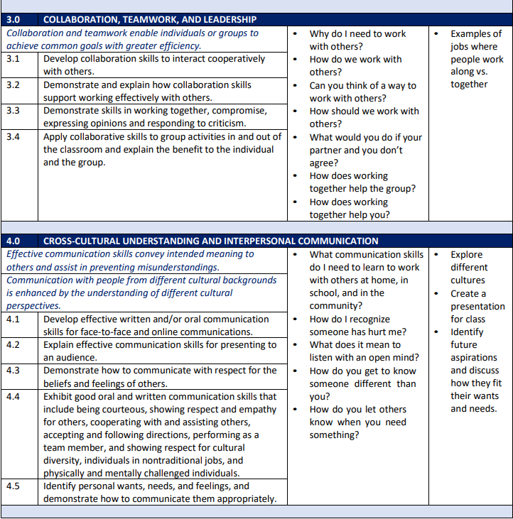
2-4 Career Literacy

Slide 12
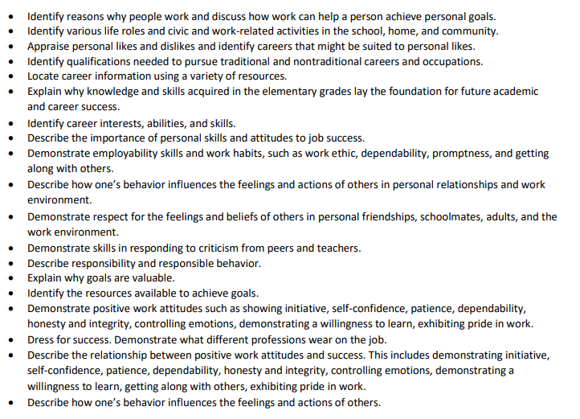
Strategies 2-4

Slide 13
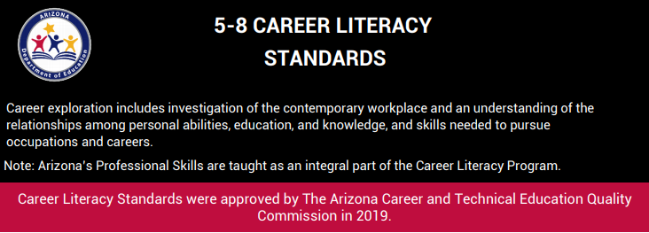
5-8 Career Literacy
5-8-Career-Literacy-Standards.pdf (azed.gov)

Slide 14
5-8 Career Literacy
1.0 Career Research
2.0 Critical Thinking and Problem Solving
3.0 Collaboration
4.0 Interpersonal Communication
5.0 Technology
6.0 Accountability and Ethics
7.0 Personal Responsibility

Slide 15
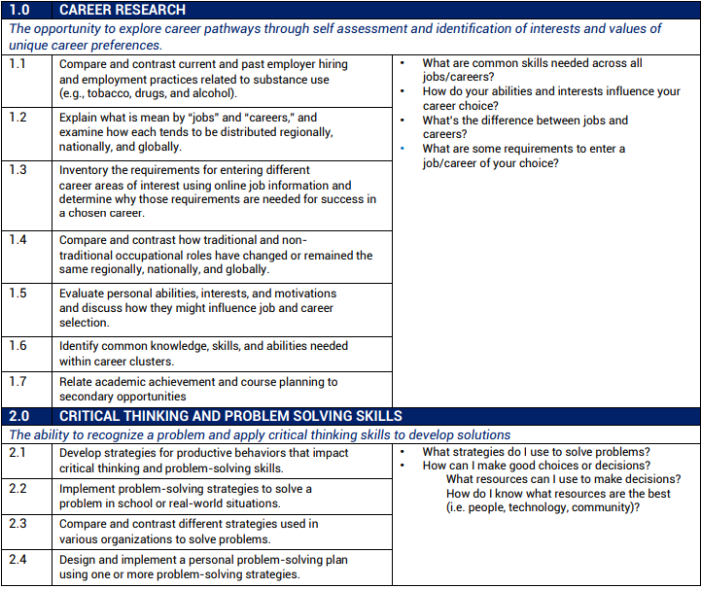
5-8 Career Literacy

Slide 16
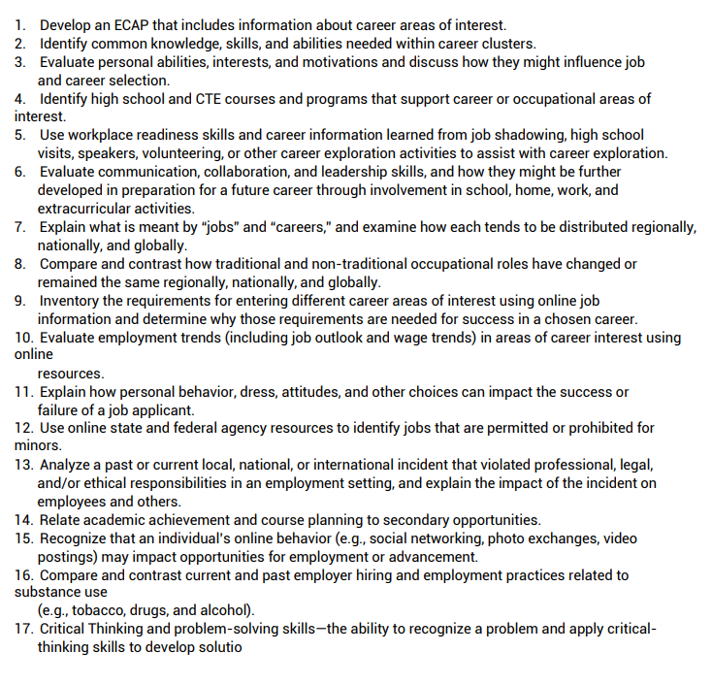
Strategies 5-8

Slide 17
Recommendations
Review what you are already doing
Share with your teachers – see how you can collaborate
Encourage admin to work with teachers to identify these standards in their lessons
Don’t panic – these are not mandated but should guide your work in your school counseling program
Scope & Sequence – long term development

Slide 18
Resources
ADE Career Literacy Page
www.azed.gov/cte/arizona-career-literacy
ASCA Career Conversation Starters
Toolkits & Frameworks - American School Counselor Association (ASCA)

Slide 19
Bonus Article – Career Advising
The State of Career and Technical Education: Career Advising and Development
https://www.schoolcounselor.org/asca/media/asca/Publications/State_of_CTE_Career_Advising_Development_2018.pdf

Slide 20
Contact Information
Amanda Nolasco
School Counselor Specialist
amanda.nolasco@azed.gov
www.azed.gov/cte/counselors
@mrs_anolasco
Amanda Nolasco
School Counselor Connection - Click to get the newsletter or update your information

