Slide 2
2018-2019 HOSA Updates 2018 ACTEAz Summer Conference Aden Ramirez Arizona HOSA State Advisor
Notes:
.

Slide 3
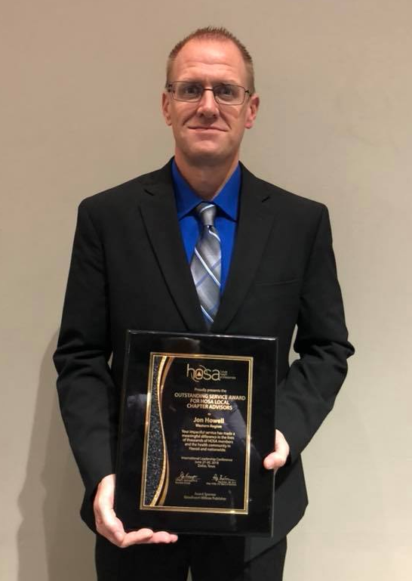
2018 ILC highlights
26 top 10 finalist
3 Bronze medalists – GIFT
1 Silver medalist – Desert Vista HS
1 Gold medalist – GCU
1 HCI Mastery Level – Alexandra Rolfness
Jon Howell – EVIT – GoodheartWilcox Outstanding Service Award
EVIT – Most Fundraised for National Service Project
GCU Largest Postsecondary/Collegiate Chapter
Outstanding State Leader – Elizabeth Church
Sandi Oligny and Mark Wireman – Outstanding Local Advisors

Slide 4
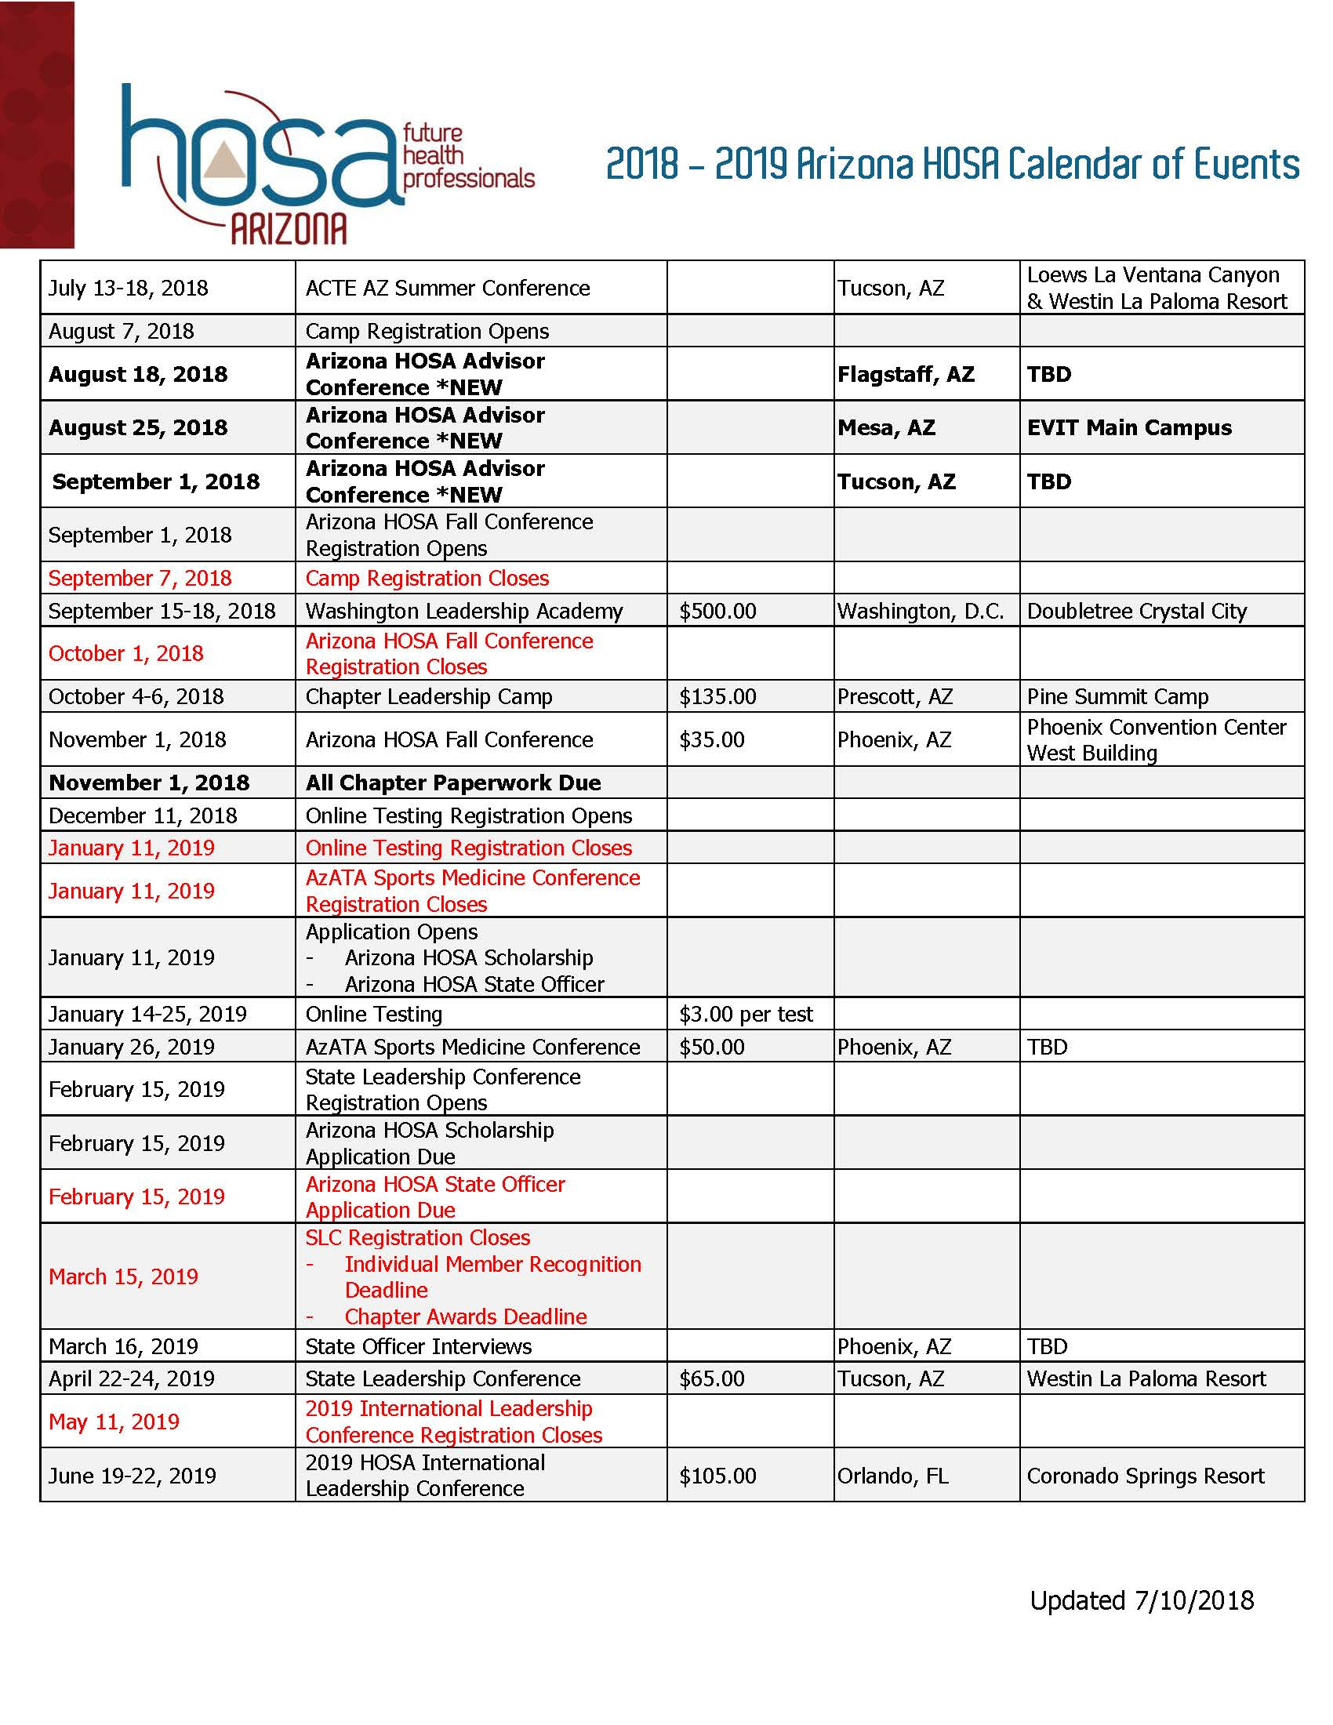
2018-2019 Calendar
New Events
Advisor Conferences
August 18, 2018 – Flagstaff, AZ (TBD)
August 25, 2018 – Mesa, AZ (EVIT)
September 1, 2018 – Tucson, AZ (TBD)
http://bit.ly/azhosaadvisor for registration
Event Name Changes
FLEX Conference is changing to Arizona HOSA Fall Leadership Conference
Spring Leadership Conference is changing to State Leadership Conference

Slide 5
2018-2019 Calendar
Event Changes
Chapter Leadership Camp
Arizona HOSA is separating from Arizona FCCLA
Cost is going down from $150 to $135
New camp director and format
Fall Leadership Conference
Splitting from FBLA and FCCLA
Registration starting at 8:30 am
Opening with 4 workshop sessions

Slide 6
General Updates for 18’-19’
Revamp of individual and chapter membership recognition awards
All awards will be submitted online by either Wufoo Forms or STEM Premier
Individual
Bronze will be submitted by advisor via spreadsheet and submitted to Wufoo Form
Silver, Gold, and Platinum membership recognition award will be submitted by members via STEM Premier
Change in requirements
Chapter
Will be submitted via online Wufoo form
Change in requirements
Continued use of the National HOSA Conference Registration System and testing system

Slide 7
General Updates for 18’-19’
Formation of Regional Conference Exploration Committee
If interested reach out to Aden Ramirez at aden.ramirez@azed.gov
Chapter Grants
Chapters will be able to apply for a Arizona HOSA Chapter Grant up to $500
Should be used for chapters in need
Requirements and guidelines will be posted August 1st
CE Committee
The competitive events committee is in need of new members
If interested reach out to Aden Ramirez at aden.Ramirez@azed.gov
Donate Life AZ High School Challenge
Right Response

Slide 8
General Updates for 18’-19’
Finance
DO NOT use the “autogenerated” from the HOSA Conference Registration system to pay on.
These invoices have invoice numbers that we cannot match in our QuickBooks system.
Wait for a QuickBooks invoice from Arizona HOSA (will be sent via email).
These invoices will come out later than they have in the past since we have a our finance company has to put them together.
Our goal is to have invoices out a week after the registration deadline.

Slide 9
General Updates for 18’-19’
New Resources
Advisor Handbook coming out during Advisor Conferences
Policies and Procedures
Will be voted on at next BOD meeting
New Website
Modern
Cleaner
Easier to navigate

Slide 10
2018 - 2019 State officers
Adrian Kwiatkowski
President
Red Mountain HS
Josie Dahir
Historian Reporter
University of Arizona
Trevor Kramer
Region 4 VP
Central Arizona College and CAVIT

Slide 11
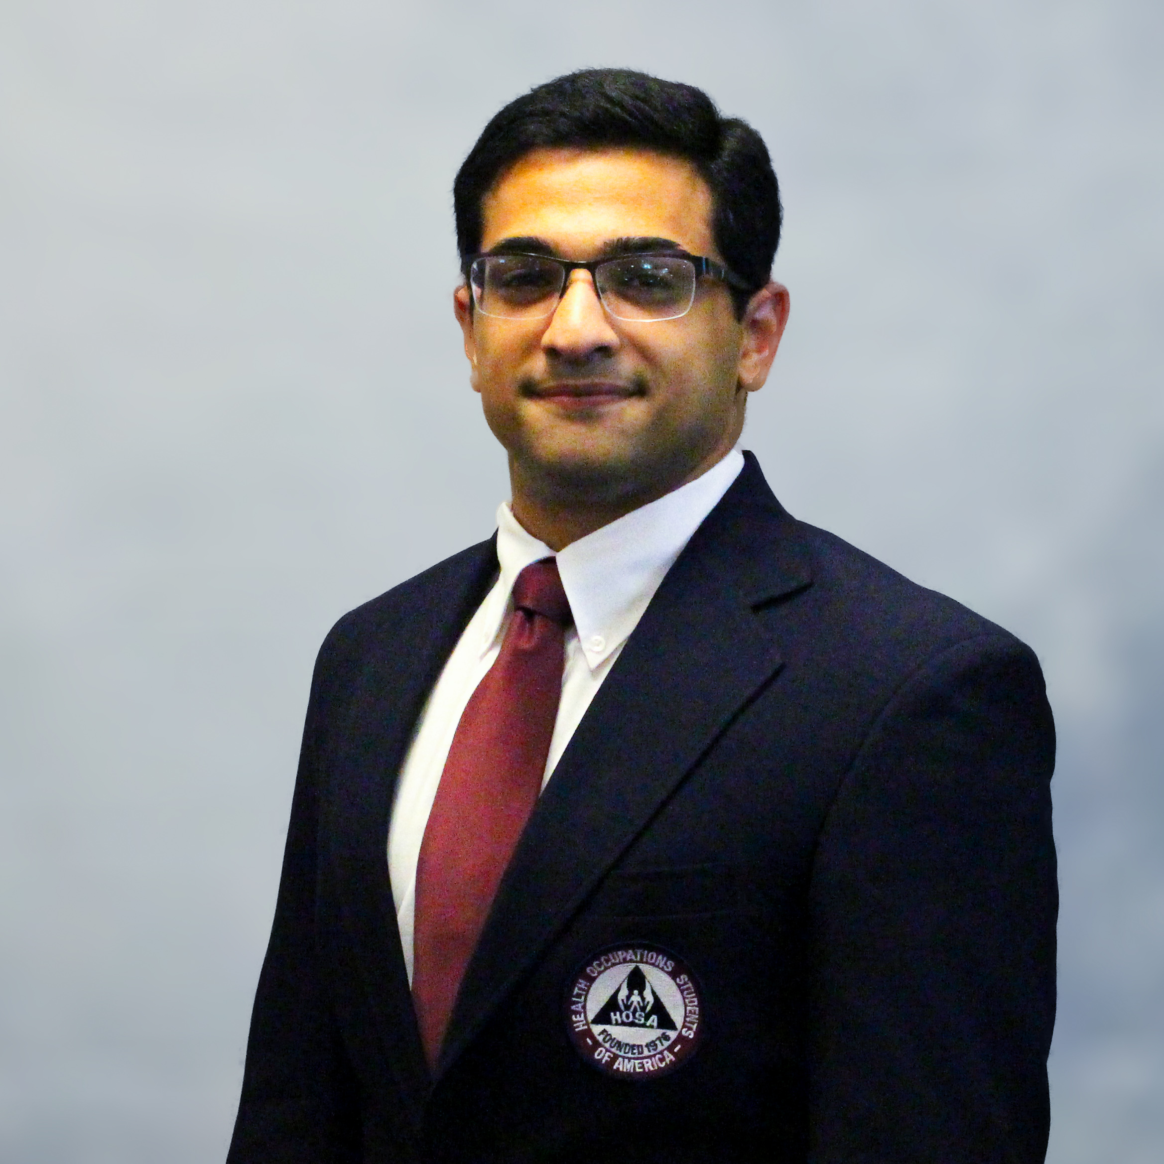
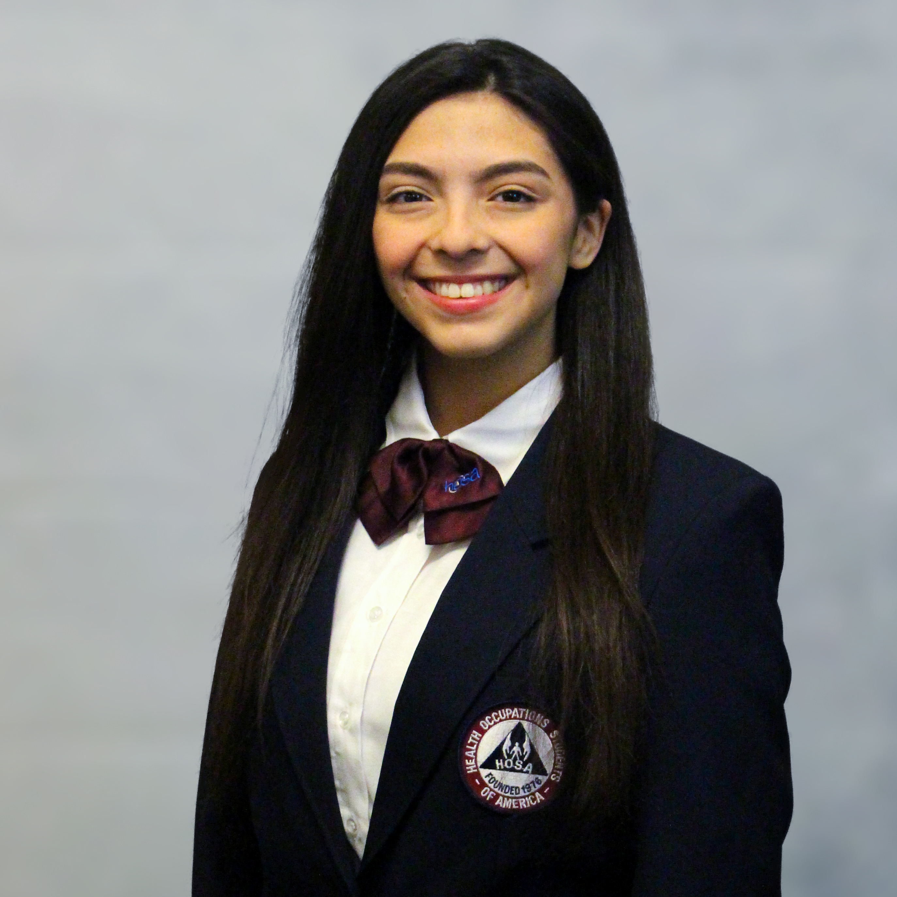
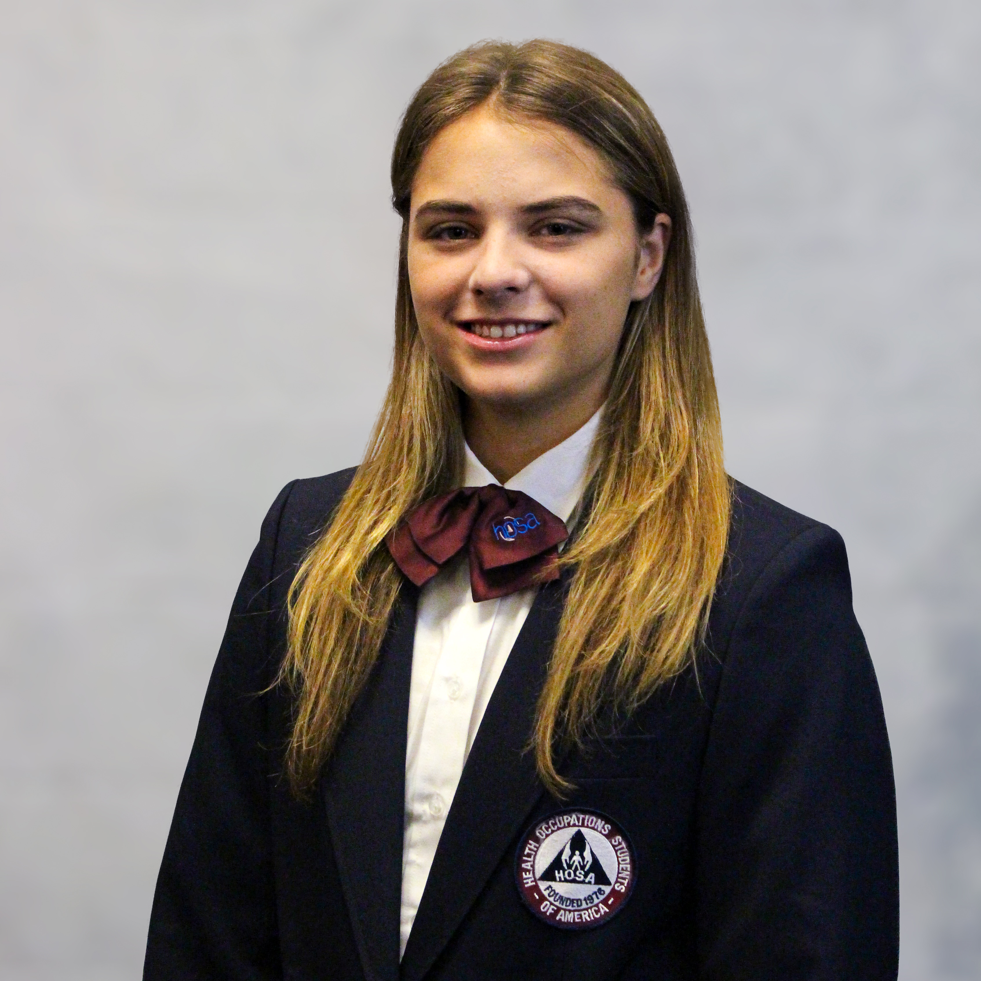
2018 - 2019 State officers
Zack Merhavy
Post Secondary Collegiate VP
Grand Canyon University
BriyaMarie Contreras
Secretary
Arizona State University
Alexandra Rolfness
Region 2 VP
Paradise Valley HS CREST
Hannah Campbell
Region 1 VP
Bradshaw Mountain HS
Javin Patel
Parliamentarian
Centennial HS

Slide 12
State Officer Goals
1. Improve Publicity
Follow Arizona HOSA on Twitter, Instagram, and Facebook
State Officer Webinars
Chapter Visits
2. Increase non-secondary engagement
Revive/ start Post-secondary and middle school chapters
3. Supporting & Raising awareness for the National Service Project
The National Pediatric Cancer Foundation

Slide 13
2018-2019 Arizona HOSA Theme

Slide 14
HOSa competitive event updates 18’-19’

Slide 15
CE UPDATES
STEM Premier Uploads
Health Career Photography
- Facility and subject permission forms as well as written descriptions
Health Education & Community Awareness:
- A pdf of the portfolio
GRR Item #30 Event Timing
The option to provide tablecloths has been removed for display times
Notes:
GRR #30 has been updated re: event timing. Alternate teams that already arrive with Round 2 qualifiers (per guidelines) will be called up if teams are over 5 minutes late to keep the event running on time.

Slide 16
CE UPDATES
HEALTH SCIENCE EVENTS

Slide 17
Medical Reading SS/PSC
Leadership and Self-Deception, Getting Out of the Box by The Arbinger Institute
In Shock, My Journey from Death to Recovery and the Redemptive Power of Hope by Rana Awdish
Internal Medicine: A Doctor’s Stories by Terrence Holt
The Book of Blood: From Legends and Leeches to Vampires and Veins by HP Newquist
Complications: A Surgeon’s Notes on an Imperfect Science by Atwul Gawande

Slide 18
Medical Reading- MS
The Book of Blood: From Legends and Leeches to Vampires and Veins by HP Newquist
Making Rounds with Oscar: The Extraordinary Gift of an Ordinary Cat by David Dosa
Throwaway Players by Gay Culverhouse

Slide 19
CE Updates
HEALTH PROFESSIONS

Slide 20
HEALTH PROFESSIONS
Nursing Assisting: The glass thermometer in Skill VI has been removed. The skill will be done via electronic thermometer.
Sports Medicine: In Skill I, the warm up will now be verbalized as opposed to demonstrated. The stretch will be demonstrated for 5 seconds instead of 20-30 seconds.
Working with National Partners for overall guideline revision coming 2019-2020.

Slide 21
CE Updates
EMERGENCY PREPAREDNESS

Slide 22
Emergency Preparedness
EMT: The guidelines for EMT are aligned with the NREMT psychomotor skills. Those guidelines were updated 6.1.18. Look for changes in name of skills and order of steps.
EPIDEMIOLOGY: The case studies will be changed from short answer to multiple choice.
PUBLIC HEALTH
A table will be added to the round one presentation for props.
Battery operated equipment will be allowed in both rounds.

Slide 23
PUBLIC HEALTH TOPIC
Civilian Readiness
Life threatening emergencies can happen fast. Recent current events (natural disasters, mass shootings, violent protests, school and workplace violence, active shooters, etc.) have shown the importance of and need for civilians to be ready and prepared.
In your Public Health presentation, educate the public about one aspect of civilian readiness. What kind of action steps can be taken by individuals in response to traumatic events?
Notes:
Examples of current initiatives include “Until Help Arrives” and “Stop the Bleed.”

Slide 24
CE Updates
LEADERSHIP

Slide 25
LEADERSHIP
Health Career Photography:
Notes will be allowed to be used in Rd 2, but electronic notes may NOT be shown to judges.
Healthy Lifestyle: Expect new guidelines to include information on how to set appropriate healthy lifestyle goals.

Slide 26
Prepared Speaking/ Speaking Skills Topic
Notes:
Theme for next year – and our PS and SS topics

Slide 27
Leadership
Researched Persuasive Writing and Speaking:
The event will return to a to a single round. Both the paper and presentation will be judged.

Slide 28
Researched Persuasive writing and speaking
3D Printing-Based Technology Should be Used to Create Human Organs
Police Officers Should Be Required to Carry Naloxone

Slide 29
CE Updates
TEAMWORK

Slide 30
Teamwork
Medical Innovation:
Round One and Round Two
Round One will rate the innovation display and Round Two will evaluate the presentation, similar to HCD.

Slide 31
teamwork
Public Service Announcement: Notes will be allowed to be used in Rd 2, but electronic notes may NOT be shown to judges.
Forensic Medicine: Name change to Forensic Science.
Parliamentary Procedure: Competitors must now read aloud the minutes from the previous meeting. It will not be acceptable to indicate minutes have been previously sent.

Slide 32
Biomedical Debate topic
Pain Management:
Opioids are the best solution!

Slide 33
PSA topic
Be the First ..... tobacco-free generation!
Be part of a change agent to make a difference and make a commitment to help people in your communities and, better yet, in your lives lead tobacco-free lives!
Sponsors: CVS Health and USPHS and the
Office of the Surgeon General

Slide 34
CE Update
RECOGNITION

Slide 35
RECOGNITION
HCIE: Dates for state testing will be from July 1 - Nov 1st. Dates for ILC testing will be from Jan 1 – May 15th.
HOSA Happenings: A state submission option in electronic format to STEM Premier has been added. Check with your state for which process they will use.
Outstanding HOSA Achievement: The email submission will be changed to a STEM Premier upload.

Slide 36
Recognition
Outstanding HOSA Chapter:
Middle School Division will have the same areas of work but a decrease in the number of activities needed for recognition. Needed points will be 24 for state and 28 for ILC.
Clarification has been added that the Outstanding Chapter book is the property of the chapter.
Alumni Gold Chapter Recognition will be added to the rating sheet worth 4 total points.

Slide 37
Thank you and Raffle
Questions?
Prizes

