Slide 1
Welcome to Behind the Curtain: Intimate Skills for Health and Wellness Careers
Presented by:
Michael Tapscott
Gateway Community College, Senior Instructor

Slide 2
Gratitude How much gratitude is in your attitude?

Slide 3
Show of Hands
Are you here because you are specifically interested in Massage?
Are you here because you are in a Health and Wellness field other than Massage?
Who’s left?

Slide 4
Original Title for This Course
17-Year-Olds, Nudity, and Oil:
What could possibly go wrong?

Slide 5
Identify the “What Could Go Wrong?”
Students refuse to be worked on by certain students
Parents create obstacles that make learning hard or nearly impossible
Students touch one another inappropriately
Students claim teacher touched them inappropriately
The world as I know it ends!

Slide 6
Strategies to Mitigate
Strict rules
Stricter consequences
Lots and lots of release forms

Slide 7
Rules and Standard Classroom Management
Textbook teaching
But does it work?
Notes:
Take a few moments to write down answers to questions and be prepared to share with group
NEED GATEWAY NOTEBOOKS

Slide 8
Culture
Rules are what you follow when someone is watching.
Culture is what you follow when no one is watching.
And only one affects desire itself…

Slide 9
Culture
“Culture is important, but I have lots of important things to do. I just don’t ever have enough time.”
If you don’t have enough time for creating an effective culture, you won’t have enough time for dealing with all the problems that follow…

Slide 10
Culture
You create it everyday.
But how?

Slide 11
Culture
What culture do you actively create?

Slide 12
Culture
What are your priorities?

Slide 13
Culture
Your culture is your priorities.

Slide 14
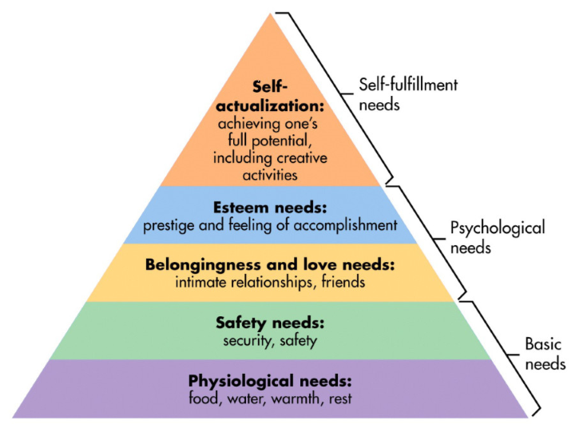
Culture
Has to address the emotional needs of the teenager first.

Slide 15
Culture
Learning occurs at all levels, but it tends to be about how to operate in that particular level.
The environment sets the parameters or limits of
the learning.

Slide 16
Culture
The purposeful culture you create has to be from the pyramid and in a bottom up priority:
Food, water, shelter
Security and safety - both physically and emotionally
Healthy relationships
Self-esteem
Learning about the material

Slide 17
Culture
Food, water, shelter – you can eat in class
Emotional safety – gratitude and teacher vulnerability
Healthy relationships – gratitude and teacher vulnerability
Self-esteem – celebrating individual strengths and successes
Learning about the material – clear and simple

Slide 18
Culture
Self-actualized individuals behave much better than people in survival mode.

Slide 19
Everyday You Must
Greet every student by name as they come into class
Perform the Gratitude Exercise with no judgement, supporting individuality, and revealing your vulnerability to support theirs
Catch your students doing things right and make a big deal out of it.
Require them to follow the one class rule – be nice – actively.
Let everything else go so you don’t water down the message
that is delivered by your priorities

Slide 20
Your Priorities
Be grateful
Be actively nice
Be vulnerable
Actively look for legitimate things to praise
Sell your message by modeling it
Let everything else go
P.S. Email parents regularly in the beginning – in the good old days.

Slide 21
Gratitude
It’s a practice not a saying.

Slide 22
Be Actively Nice
Look for ways to serve your students.
You have to model the behavior you want.

Slide 23
Being Vulnerable…
Admit when your wrong
Look for students being right
Share your short comings and how you manage them
Share your fears and how you manage them
Show your feelings but also show how you are in charge of them

Slide 24
Vulnerable is not weak
You’re real, not a real mess.
Your feeling affect you; they don’t control you.
You can empathize with everyone’s humanity.
Let them know that life is often scaring and confusing for you too. But model how you manage that.

Slide 25
Look for things to praise
But they have to be honest.

Slide 26
Model it!
Students believe what you do not what you say.
If you’re not living it, it’s not true.

Slide 27
Let the rest go…
What do you really want your students to leave with?
Every statement you make waters down the message soup.

Slide 28
From Teacher to Leader

Slide 29
Great Leaders
Put the needs of others in front of their own
Ask themselves how what they are doing will improve the emotional state of the person in front of them.
Leaders use their authority as a last resort because authority crushes safety and security.

Slide 30
Zappos
"At Zappos, our belief is that if you get the culture right, most of the other stuff - like great customer service, or building a great long-term brand, or passionate employees and customers - will happen naturally on its own.”
Tony Hsieh

Slide 31
Microsoft
“If I was down to my last dollar I would spend it on Public Relations.”
Bill Gates

Slide 32
The Container Store
“You can build a much more wonderful company on love than you can on fear.”
Kip Tindell

Slide 33
National Information Solutions Cooperative
“I used to believe that culture was ‘soft,’ and had little bearing on our bottom line. What I believe today is that our culture has everything to do with our bottom line, now and into the future.”
Vern Dosch

Slide 34
Netflix
“Over the years we learned that if we asked people to rely on logic and common sense instead of on formal policies, most of the time we would get better results, and at lower cost.”
Patty McCord, Chief Talent Officer

Slide 35
Switching Gears
From culture to curriculum

Slide 36
Curriculum
There is no state requirement for specific Massage Curriculum.

Slide 37
Curriculum
You can teach to the text book.
You can teach to the MBLEx or the Arizona CTE Standards.
You can teach to the job.

Slide 38
Industry Feedback
“They don’t know their anatomy.”
“They can’t do deep tissue.”
“And they don’t have people skills.”
“Oh, and that’s if they show up at all.”

Slide 39
Workforce trends as we see them
Consumers utilizing massage
Employment
demand
Big schools
Enrollment
Pay (adjusted for inflation) is flat

Slide 40
Curriculum
The economics do not support more education or longer programs.

Slide 41
Curriculum
D
E
P
T
H
vs.
700 Hours
B r e a d t h

Slide 42
Curriculum
Massage is a skill,
built on a foundation
of basics and practice.

Slide 43
Curriculum
Attendance, Attitude, and Anatomy
Gratitude everyday
Anatomy everyday
Massage everyday
Three clinics per program
Focus on deep tissue

Slide 44
Curriculum
Train: Attendance, Attitude, and Anatomy
Gratitude everyday
Anatomy everyday
Massage everyday
Three clinics per program
Focus on deep tissue

Slide 45
What did you learn today?
Students have to choose to learn.
Notes:
Ask group to assign a scribe and reporter upon completion

Slide 46
Thank you for participating!
Questions:
Michael Tapscott
michael.Tapscott@gatewaycc.edu

Slide 47
Rate My Professor
Best Teacher ever ! Changed my life & helped me with problems! He was like another father to me.
Taking this class was one of the best decisions of my life. The Class, especially the teacher, made it interesting, fun and it was a major growing experience overall.
Such an amazing teacher and mentor. He gives excellent feedback and critique while encouraging you to utilize your own form of massage. He is knowledgeable and reliable. If you have any concerns he encourages sending him an email and he will help how he can.
Tapscott was the most amazing teacher ever and his class was so professional and fun at the same time. Everything we did related directly to class and I've never been in a better learning environment. He made this class the best and ultimately, I would recommend him and his class to every single person.

Slide 48
Yelp
I had the honor and privilege of being enrolled in the Massage Therapy program through West Mec. Our instructor, Michael Tapscott made everyday an absolute BLAST! The way he cares for his students and takes the time to help us with any situation, whether it's at school or in our personal lives is truly inspirational. He's a big advocate on creating a positive environment for his students, and not allowing drama to be a factor in his classroom. The ENTIRE class became one big family and we all got along with each other. I feel incredibly blessed to have been a part of the West Mec Massage Therapy program, and I'm going to miss every second of it dearly.
My instructor was Michael Tapscott. He was the instructor for the Massage Therapy program at the Deer Valley campus. I absolutely loved everything about the program and the instructor. We learned a ton about anatomy, physiology, massage and so much more. He is extremely kind and sees the good in everyone! You will learn things in this course that you won't learn anywhere else! I strongly recommend the program and Michael Tapscott as an instructor.

Slide 49
West-Mec Student Surveys

Slide 50
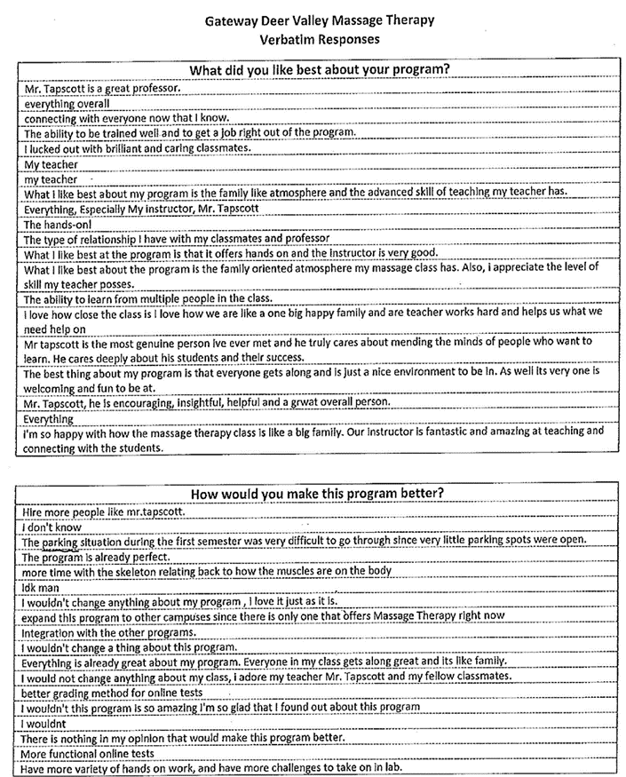
West-Mec Student Surveys

