Slide 1
Robyn Bryce
Technology Integration Specialist | Prescott Unified School District #1
\||EdTechTEam
A Dozen Tech Tools to Support the 4C’s
Resources
Interested in MORE?
@ms_robyn_bryce

Slide 2
A Dozen Tech Tools to Support the 4C’s
@ms_robyn_bryce

Slide 3
The 4Cs
@ms_robyn_bryce

Slide 4
COMMUNICATION
@ms_robyn_bryce
Notes:
Mystery Hangouts

Slide 5
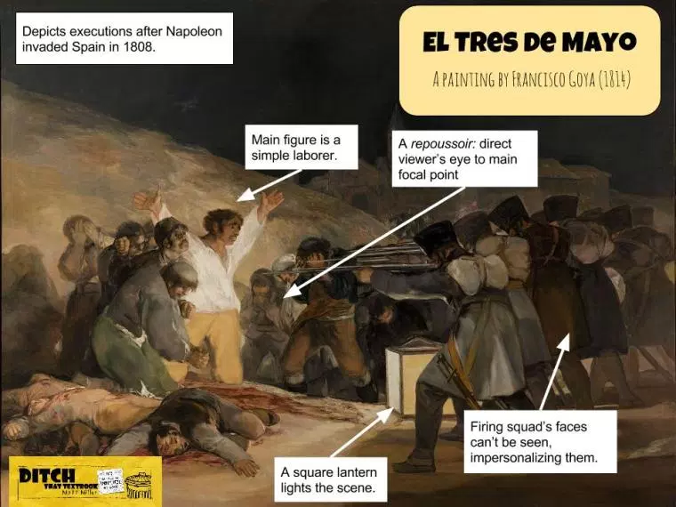
CREATIVITY
@ms_robyn_bryce
Notes:
Mystery Hangouts

Slide 6
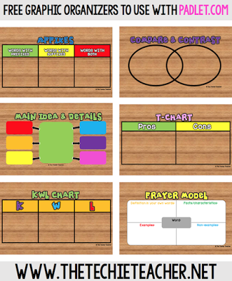
COLLABORATION
@ms_robyn_bryce
Notes:
Mystery Hangouts

Slide 7
CRITICAL THINKING
@ms_robyn_bryce
Notes:
Mystery Hangouts

Slide 8
Choose a tool that you learned about today. How do you think you will use that tool in your next meeting, PD, or class?
@ms_robyn_bryce

Slide 9
Questions?
@ms_robyn_bryce

Slide 10
@ms_robyn_bryce

Slide 11
Access Session Resources Here
@ms_robyn_bryce

