Slide 1
What the Research Says July 2015
Brought to you by your ACTEAZ

Slide 3
TIME Magazine
National Public Radio
USA Today: “About 31-35% of Americans graduate from some type of college these days…But we need to better prepare the other 65-70% (for jobs earning a middle-class living) in the 21st century.”
Everybody Is Talking About CTE
Notes:
TIME Magazine: The School That Will Get You a Job. February 13, 2014
USA Today: Career Education Classes Explode in Variety. February 16, 2014
NPR: Ready to Work--http://www.americanradioworks.org/documentaries“ www.AmericanRadioWorks.org/documentaries

Slide 4
Everybody Is Talking About CTE
AFT: “A strictly academic curriculum has been prioritized to the detriment of career and technical education (CTE), which provides the link between the needs of the labor market and the needs of young people to be prepared for life after high school.”
OECD: “VET has been oddly neglected and marginalized in policy discussions, often overshadowed by the increasing emphasis on general academic education and the role of schools in preparing students for university education.”
Notes:
American Federation of Teachers: American Educator. Winter 2014-15
OECD: Skills Beyond High School. February 13, 2014

Slide 5
Everybody Is Talking About CTE
Georgetown, Business Round Table and College Board: The Promise of High Quality CTE— “High-quality Career and Technical Education (CTE) — as distinguished from older models of vocational education — has great potential to improve student educational attainment and worker earnings, as well as outcomes for firms and the U.S. economy.”
Notes:
The Promise of High Quality CTE: http://www.careertechnj.org/wp-content/uploads/2013/11/Georgetown.BR_.CB-CTE-report-11.2013.pdf

Slide 6
It’s No Surprise

Slide 7
Youth Unemployment
Notes:
NPR: A Lost Generation of Workers: http://www.npr.org/2014/07/02/327058018/a-lost-generation-of-workers-the-cost-of-youth-unemployment
5.8 million young people are neither in school or working

Slide 8
Staggering Student Debt
Student loan debt: 40 million Americans have outstanding loans. Up from 29 million in 2008.
Average debt is $29,000.
“Loan-ageddon”
Notes:
Slate: http://www.slate.com/articles/business/moneybox/2014/03/graduate_school_debt_is_it_a_crisis.html
African American students are more likely to borrow to attend a public college than their white and Hispanic counterparts suggesting that student debt is perpetuating racial inequality. Market Watch. Mary 19, 2015

Slide 9
College Completion
Notes:
Source: William Symonds. Global Pathways Institute

Slide 10
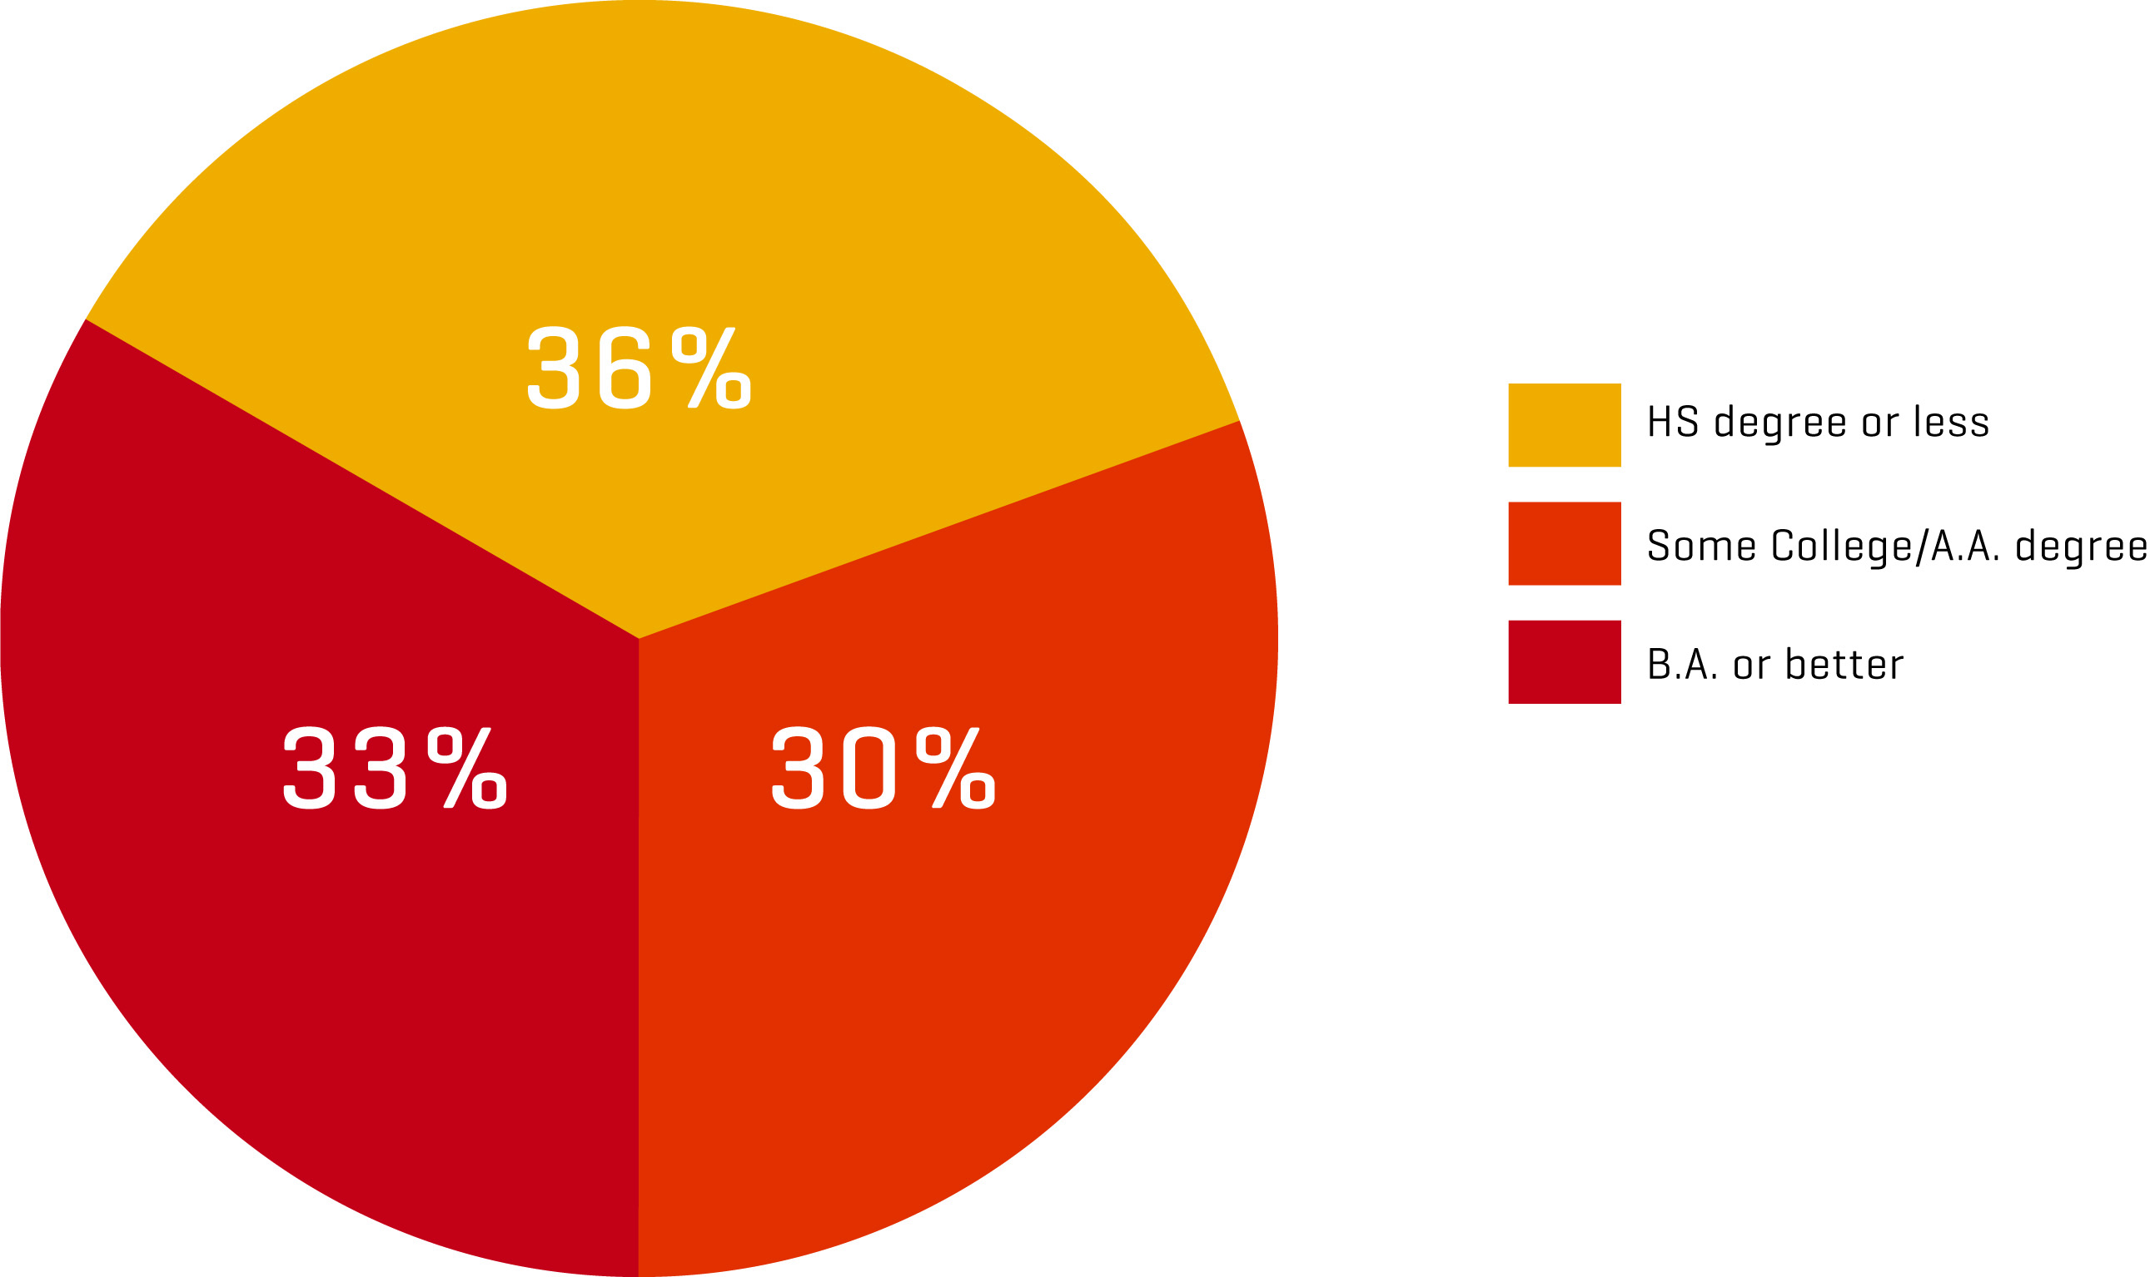
The Skills Gap
Source: March CPS data, various years; Center on Education and the Workforce forecast of educational demand to 2018.

Slide 11
The Skills Gap, Take Two
Middle skill jobs currently represent 48% of workforce (69 million jobs)
Boomers retiring
47% of all new job openings from 2010 to 2020 will fall into the middle skill range
Source: Harvard Business Review
Who Can Fix the Middle-Skills Gap? January 2015
Notes:
Harvard Business Review, Kochan, Finegold and Osterman: Who Can Fix the Middle Skills Gap?
Who Can Fix the “Middle-Skills” Gap? https://hbr.org/2012/12/who-can-fix-the-middle-skills-gap?utm_source=Middle+Skills+Gap+-+Looming+or+present+crisis%3F&utm_campaign=middle-skills_gap&utm_medium=email

Slide 12
Achievement

Slide 14
CTE Outcomes
Graduation rate
Drop out rate
Postsecondary education completion rate
Credential acquisition

Slide 15
Student Engagement Update
Graduation rate for 2013—81%
Students of color are making the biggest gains
Graduation rate for low-income kids is 15% lower than their more affluent counterparts
More than one dozen states fell below the national average—including AZ. Income-based graduation rates widened, too.
Notes:
Source: Where Dropping Out Is Going Up, The Atlantic; May 15, 2015

Slide 16
Notes:
Source: Jim Stone, National Center for Research in CTE

Slide 17
Notes:
Source: Jim Stone, National Center for Research in CTE

Slide 18
Notes:
Source: Jim Stone, National Center for Research in CTE

Slide 19
Notes:
Source: Jim Stone, National Center for Research in CTE

Slide 20
Community College Update
15% increase in number of degrees and certificates awarded by AZ community colleges between 2011and 2013
On track to reach goal of 44,000 associate degrees and/or certificates per year by 2020
Notes:
Source: AZ. Gov. Arizona Report Cards. Spring 2015.

Slide 21
Programs of Study Research
Rigorous Test of Student Outcomes in CTE Programs of Study: Final Report
“Earning more CTE credits was associated with graduation”
“Students in programs of study/career pathways outperformed their peers on the number of credits they earned in STEM and AP classes”
Notes:
NRCCTE: Rigorous Tests of Student Outcomes in CTE Programs of Study: Final Report: http://www.nrccte.org/resources/publications/rigorous-tests-student-outcomes-cte-programs-study-final-report

Slide 22
Everyone Is Talking About Career Literacy
Pathways to Prosperity
Necessary but Not Sufficient: A report by the Arizona Ready Education Council’s Graduation Rate Task Force
Skills Beyond School by OECD
The Global Pathways Institute
And more………

Slide 23
Children in Poverty
For the first time in 50 years, a majority of U.S. public school students come from low income families.
CTE can fix the “mobility escalator”
Notes:
The Washington Post: The Majority of U.S. Public School Students Live in Poverty. http://www.washingtonpost.com/local/education/majority-of-us-public-school-students-are-in-poverty/2015/01/15/df7171d0-9ce9-11e4-a7ee-526210d665b4_story.html

Slide 25
CTE Delivery Model

Slide 26
Challenges/Aspirations
Strong career options for all students
Career development
Academic integration
Rigorous curricula addressing technical and employability skills
Project based and work-based learning
Appropriate assessments
Notes:
Holzer, Linn and Monthey. The Promise of High Quality Career and Technical Education. October 2013
OECD. Skills Beyond School—Synthesis Report. November 13, 2014

Slide 27
High-quality CTE
“Not all CTE we find in today’s public schools provides the proper beginning of a career pathway—a pathway that builds on credentials business and industry recognize and value.”
James Stone, NRCCTE

Slide 28
High-quality CTE
“What is needed is a re-visioning of CTE …providing students with the skills they need to move through a viable career pathway and continue their education and training to make that pathway a reality. What is needed is high-quality CTE.”
James Stone, NRCCTE

Slide 31
Worth Reading
Holzer, Linn and Monthey. The Promise of High Quality Career and Technical Education. October 2013
Catellano, Sundell, Overman, Richardson and Stone. Rigorous Tests of Student Outcomes in CTE Programs of Study: Final Report. April 2014
OECD. Skills Beyond School—Synthesis Report. November 13, 2014
New America. New American Education Policy: Beyond the Skills Gap Making Education Work for Students, Employers and Communities. October 2014

Slide 32
Need more information?
For more CTE research visit:
The CTE Research Clearinghouse at http://www.acteonline.org/clearinghouse.aspx
The National Research Center for CTE at www.nrccte.org
Association for Career and Technical Education www.acteonline.org

