Slide 1
What the
Research Says
Brought to you by your ACTEAZ
July 2014

Slide 2
CTE Outcomes
Graduation rate
Drop out rate
Postsecondary education completion rate
Credential acquisition

Slide 4
The Great Recession
Record youth unemployment
Mounting student college debt
Advent of the NEET concept
Not in Education, Employment or Training

Slide 5
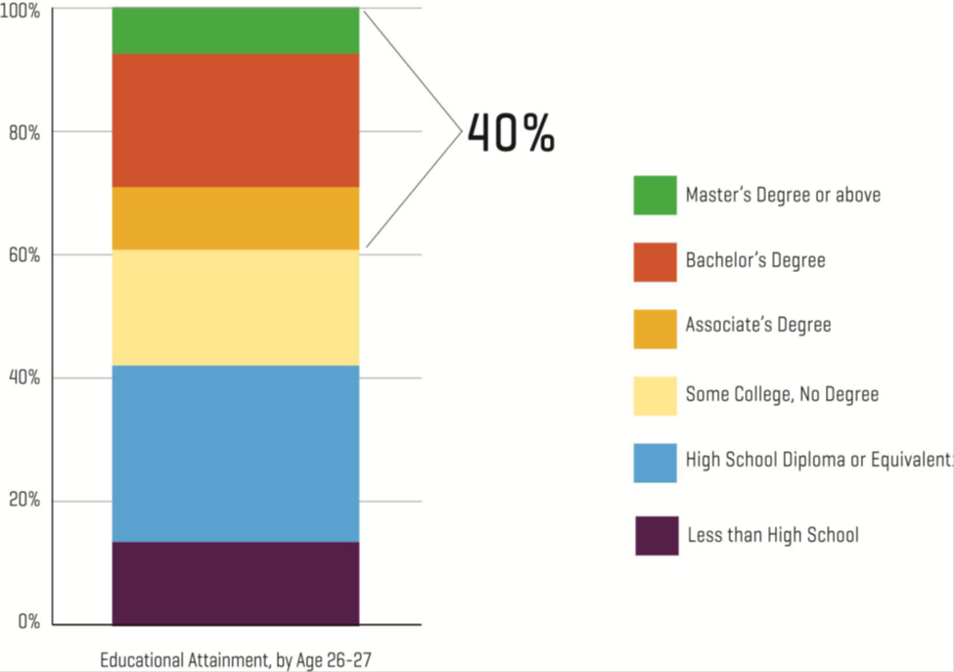
Only 40% of 27-year olds have earned an A.A. degree or higher

Slide 6


Slide 7
Getting Kids Through HS:
The First Measure of Engagement
Good News
Bad News
High School Completion = 74.7%* - Highest in 40 Years
Racial/Ethnic gap is closing
*NCES is reporting 80% for class of 2012
Variability among states: 85% in Vermont; 58% in Nevada
Hispanics and Blacks trail Whites with graduation rates by 12 and 14 points respectively; boys drop out more than girls
Source: The Atlantic June 6 2013. Slide courtesy of James Stone NRCCTE

Slide 8
On the Rise
ASU Morrison Institute for Public Policy
CTE participation does have an effect on students’ academic engagement as measured by the likelihood of dropping out and absenteeism.
  Tucson Unified – 20 – 60%
  Mesa – 79%
Notes:
Involvement in CTE reduces the likelihood of dropping out by 20 to 60% in Tucson Unified and 79% in Mesa. Students in CTE are also far less likely to be absent from school. Data from four years were analyzed. Taking two or more CTE courses is the key.
81% of dropouts said real world learning may have influenced them to stay in school.
31% of college students leave with zero credits.

Slide 9
Staying Power
Ratio of 1:2 is optimal
97% of AZ 2011-12 concentrators completed high school vs. 76% of all other AZ high school students
Nationally, 90.18% of CTE concentrators graduate as opposed to 74.9% of all freshmen

Slide 10


Slide 11
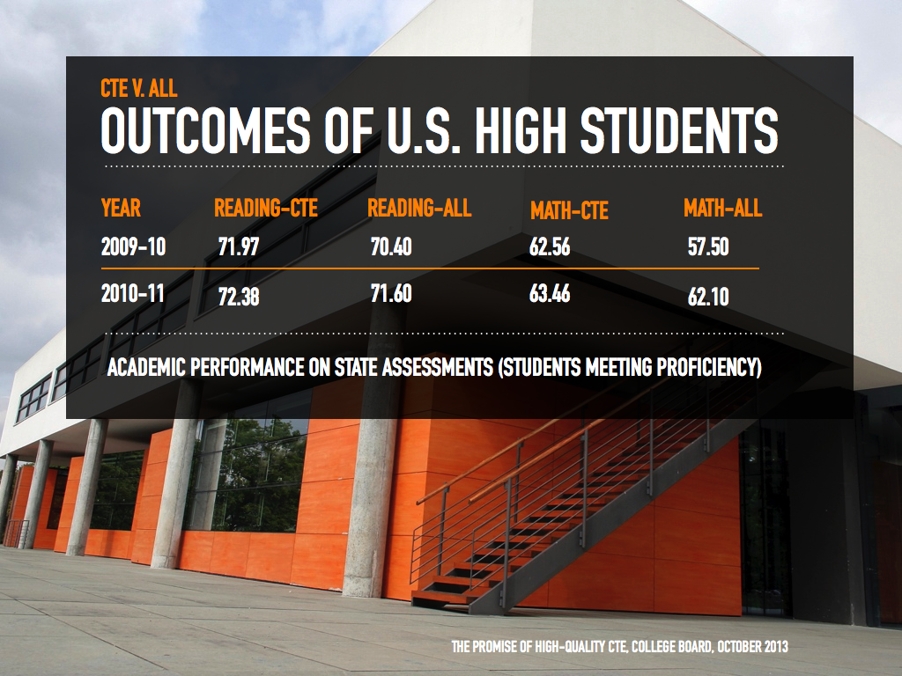
Western Interstate Commission for Higher Education
Notes:
Data reported in “Knocking at the College Door, Projections for High School Graduates. Western Interstate Commission for Higher Education with support from ACTE

Slide 12
2013 NAEP 12th grade reading and math
MATH
  2013 AVERAGE SCORE IN Mathematics increased FROM THE FIRST ASSESSMENT IN
  2005
  Unchanged FROM THE LAST ASSESSMENT IN 2009
Reading
  2013 AVERAGE SCORE IN READING decreased FROM THE FIRST ASSESSMENT IN 1992
  Unchanged FROM THE LAST ASSESSMENT IN
  2009

Slide 13
Transition
“According to data from the National Center for Education Statistics, the majority of CTE students in high school continue on to postsecondary education, and those who join the workforce outright or work to supplement their incomes as they pursue further education are often in a better financial situation than high school graduates who did not pursue CTE.”
Techniques Magazine, February 2014

Slide 14
But……..
CTE participation is declining largely due to increased graduation requirements
However….
  97% of are kids taking at least one CTE course (consistent over 15 years)
  The number who are concentrating is declining slightly
Average number of programs per school = 8.57

Slide 15


Slide 16
CEOs and College Presidents
A pervasive gap between workforce needs and the skills of entering workers
The projected growth in skilled occupations requiring technical certification or a credential beyond a high school diploma
Interest in improving high school graduation rates by helping students see connections between programs of study and career opportunities in high-wage, in-demand fields
Bridgeland, Milano and Rosenblum--Across the Great Divide: Perspectives of CEOs and College Presidents on America’s High Education and Skills Gap (March 2011)
Notes:
19% of 2011 high school grads who took the ACT and were considered college-ready in at least 3 subject areas tested never enrolled or returned for a second year of college
It’s not all about academics!

Slide 17
Economists
“There is one approach that does tend to improve graduation rates and labor market earnings especially for at risk youth: high quality career and technical education (CTE).”
Holzer, H.J. Lane, J.I. Rosenblum, D.B. Anderson, F (2011). Where Are All the Good Jobs Going.

Slide 18
Chamber of Commerce
“Encourage public/private partnerships between industry and CTE and JTEDs. Oppose any action to discontinue or reduce state and federal funding of CTE and JTEDs and restore funding for 9th grade CTE.”
Arizona Chamber of Commerce Advocacy Agenda 2014

Slide 19
Expect More Arizona
“Commit to higher expectations that prepare all children to attain a college degree or industry credential.”
Five Building Blocks. Expect More Arizona 2014

Slide 20
Arizona Ready
“Recognize that CTE provides the relevance needed for core subjects and should be positioned as an avenue for core subject credit in areas such as math, language arts and science.”
Arizona Ready Education Council, Task Force to Increase Arizona’s Graduation Rate White Paper (2013).

Slide 21
Secretary of Education
“For far too long, CTE has been the neglected stepchild of education reform. That neglect has to stop.”
Secretary of Education Arne Duncan

Slide 22


Slide 23


Slide 24
New York Times Editorial
“Who Says Math Has to be Boring”
"A More Flexible Curriculum" - including "the right mix of career and technical education”
"Experience in the Real World" - including schools that link STEM courses "to potential employers and careers, taking math and science out of textbooks and into their lives”
New York Times editorial. December 7, 2013

Slide 25
How much math do we need?
ACT—college and career ready are one and the same.
A math score of 22 is required……really?
NRCCTE* and NCEE**—what is needed is mostly middle school math skills that are applied during the high school experience.
*National Center for Research in Career and Technical Education.
**National Center on Education and the Economy.

Slide 26
Losh Report
Charles Losh argues in a paper entitled “A Review of Data Related to the Present and Future Educational Requirements of Workforce Entrants” that:
  65% of future jobs will require a high diploma or less (BLS)
  ACT WorkKeys reports that 98% of all jobs analyzed require “level 6” mathematics skills……….roughly 8th grade math by “Common Core” standards.

Slide 27
States Respond
  Florida—SG 1076 directs state board of education to create additional pathways for students to earn diplomas, with a focus on industry certifications. Some would replace certain academic requirements including Algebra II
  Texas—lower from 15 to 5 end-of-course exams. Foundation diploma with opportunities to specialize in areas like STEM, CTE program areas. Algebra II mandate eliminated.

Slide 28
States Respond--Ohio
Students have three ways to qualify for graduation and earn their high school diploma:
1. Earn a cumulative passing score on seven end-of-course exams [in algebra, geometry (or integrated math I and math II), physical science, American history, American government, English I, and English II (or in approved aligned assessments like AP, IB and dual enrollment)];
2. Earn a “remediation free” score on a nationally recognized college admission exam (such as ACT); or
3. Earn an industry-recognized credential or state license for practice in a vocation and achieve a score that demonstrates workforce readiness and employability on a job skills assessment (such as WorkKeys).

Slide 29
The ordeal of leadership…….

Slide 30
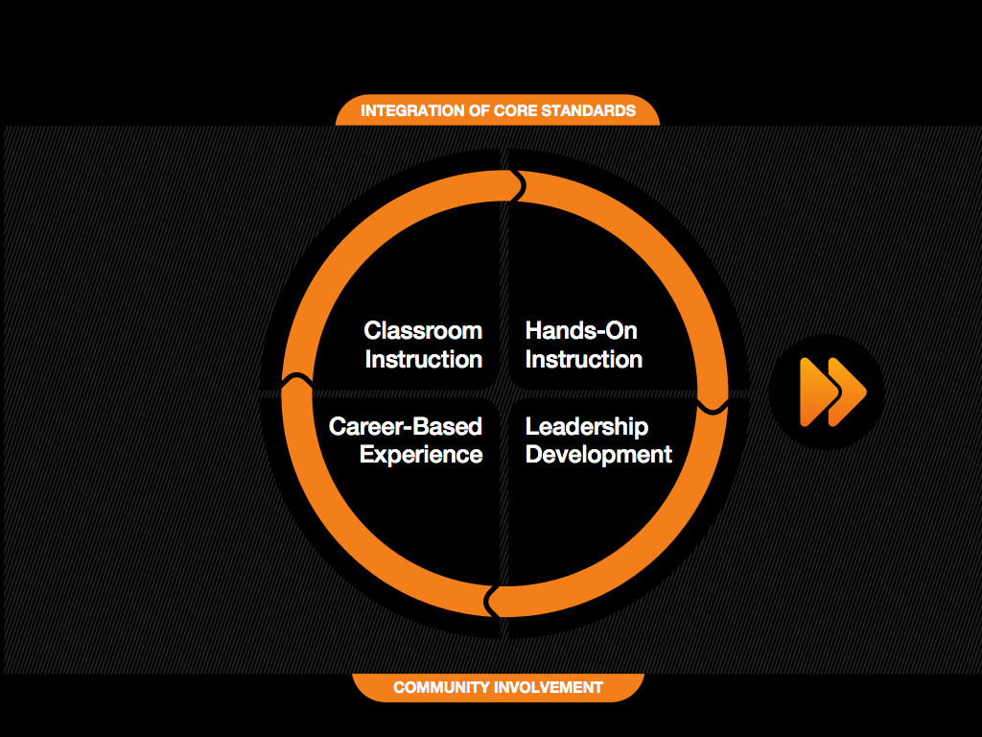

Could we pass the test?

Slide 31
Work-Based Learning
Positive correlations with graduation, academic achievement and career success.
26.1% of young people who could recall no contact with employers whilst at school went on to be come NEET(Not in Employment, Education or Training). Reduced to 4.3% for those in work-based learning. Dr. Anthony Mann, Education and Employers (2013)
Notes:
Reference for Anthony Mann article: http://www.educationandemployers.org/media/15052/its_who_you_meet_final_report.pdf

Slide 32
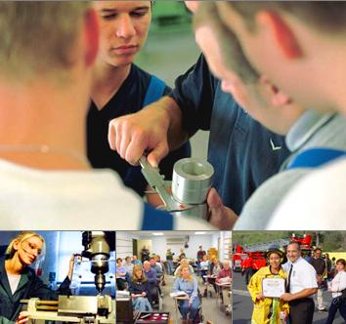
CTSOs
Involvement in CTSOs increases academic achievement, career self efficacy and employability skills.

Slide 33

Academic Content
Is it really there?

Slide 34

Career and Technical Education

Slide 35
Challenges Facing Reauthorization of Carl Perkins
More effective alignment of CTE with labor market needs;
Stronger collaboration among secondary and postsecondary institutions and industry partners;
A meaningful accountability system based upon common definitions and clear metrics for performance; and
Increased innovation supported through systemic reform of state policies and practices.

Slide 36
Worth Reading
  Pathways to Prosperity (Harvard)
  Learning for Jobs (OECD, 2010)
  Five Ways that Pay Along the Way to a B.A. Carnevale, et al., 9.18.12, Center on Education and the Workforce)
  21st Century Career and Technical Education Pathways On the Rise (Morrison Institute for Public Policy)
  Knocking at the College Door (WICHE. December 2012)
  Toward a Model of Career-Technical Education (Phi Delta Kappan, September 2013)
  Carl D. Perkins CTE Act: Implementation Issues (Congressional Research Service. December 14, 2012)
  Understanding Participation in Secondary CTE in the 21st Century: Implications for Policy and Practice (Aliaga, Katamraju, Stone. High School Journal, Spring, 2014)

Slide 37
Need more information?
For more CTE research visit:
The CTE Research Clearinghouse at http://www.acteonline.org/clearinghouse.aspx
The National Research Center for CTE at www.nrccte.org
Association for Career and Technical Education www.acteonline.org

