Slide 1
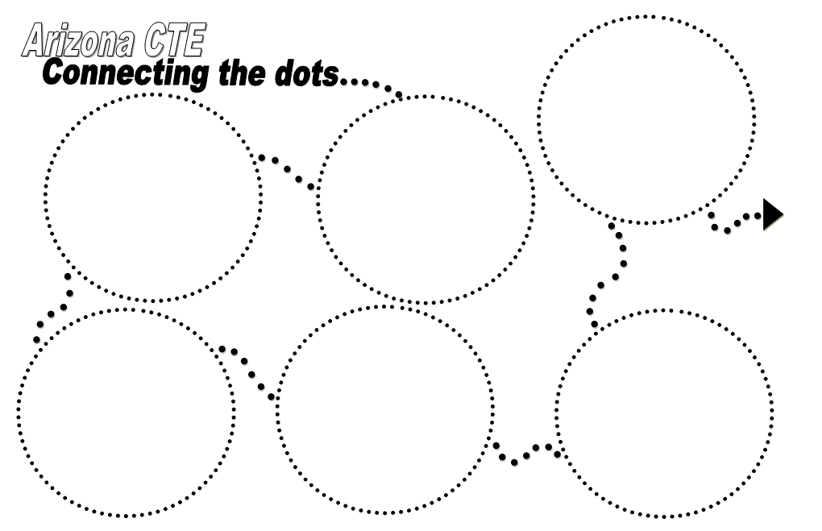

Slide 2
Why are we here?

Slide 3
Procedures for Session
Facilitators at each table
3-4 presenters followed by discussion
During discussion presenters rotate through room to answer questions
Graphic Organizer
Record questions, concerns, and recommendations
Turn document in to Curt or John at end

Slide 4
POSTERS AROUND ROOM
Identifying “Vision Elements” from the Arizona CTE Strategic Plan which are being actively worked on throughout the state
Check mark on posters to indicate which vision elements are being addressed

Slide 5
HOW CAN MY VOICE BE HEARD?
Standing Committee – 8 Individuals
Guides Strategic Plan Implementation
Composed of:
State CTE Director
ACOVA President (or designee)
ACTEAZ President (or designee)
Business & Industry Representative
Community College Occupational Deans - Representative
JTED Superintendent Representative
ADE CTE Director of Operations or Designee
AZ CTE Curriculum Consortium Director

Slide 6
Let’s get started!
Programs of Study and Rigorous Programs of Study
Programs of Study Review Process
POS Grant – Business and Industry Partnerships
Dual Enrollment Opportunities
Industry Certifications

Slide 7
Programs of Study/Rigorous Programs of Study
POS align CTE secondary programs with the postsecondary program opportunities to ensure dual enrollment; reduce duplication of instruction and encourage students to transition seamlessly to the postsecondary program.
Arizona was one of 6 states that received a federal grant to implement Rigorous Programs of Study in 2 program areas.

Slide 8
Programs of Study/Rigorous Programs of Study
ADE/CTE supported grants to 12 Program of Study Consortia in 2013 to support the development of Programs of Study.
Rigorous Programs of Study are Programs of Study that fully implement all 10 components of the national “Program of Study Framework.”

Slide 9
Key Point of Contact
Jan Brite – Arizona Dept. of Education
Jan.Brite@azed.gov

Slide 10
1. Students experience a seamless college and career development process
#5. All CTE programs delivered through a totally integrated CTE delivery model

Slide 11
POS Grant - Statewide POS review process
Valley Academy, as the fiscal agent for Arizona Programs of Study Statewide activities, will provide staff time & travel for:
Development of Data Collection and Monitoring Instruments
Statewide Data Collection
Statewide Consortia Monitoring

Slide 12
POS Grant - Statewide POS review process
Assistance to State Director with Programs of Study Professional Development and Trainings
Technical Assistance to the 12 State Consortia on using the State adopted forms & formats for data reporting
Trainings to State Consortia Schools for Data Collection practices and procedures.

Slide 13
POS Grant - Business & Industry Partnerships
Development of a contractual agreement with Sundt Construction, Inc., in conjunction with ADE/CTE, for the statewide CTE Construction Program Development.
Assistance to the State Director for the Programs of Study Project.
Assist with Statewide Data Collection

Slide 14
POS Grant - Business & Industry Partnerships
Assistance to State Program of Study Project Staff in continuing the Statewide Scope of Work for Construction Careers and Technologies
Assistance to State ADE/CTE project staff in the development of the Statewide Scope of Work
Technical Assistance to the 12 State Consortia

Slide 15
Key Point of Contact
Lois Lamer – Valley Academy Superintendent
llamer@vacte.com

Slide 16
#1 Students experience a seamless college and career development process
#9 HS Grads complete a quality concentration program that offers opportunities to obtain dual credit

Slide 17
Dual Enrollment Opportunities
Arizona has a long standing history of providing dual enrollment for opportunities for CTE students.
Dual Enrollment is a required component of establishing a “Program of Study.”
Arizona CTE is supporting efforts to increase the number of industrial credentials that are available for high school students.

Slide 18
Key Point of Contact
Jan Brite – Arizona Dept. of Education
Jan.Brite@azed.gov

Slide 19
#9 HS grads
complete a quality concentration program w/ opty to obtain dual enrollment and/or industry credentials.

Slide 20
POS Grant – Industry Certifications
Identify both NAVIT Secondary Nursing Assistants and Northland Pioneer College (NPC) Post-Secondary Nursing Potential Completers and provide them information on how to be reimbursed for the cost of their certification and certification exam. NAVIT will require that each student provide copies of certificates and testing fee receipts to be reimbursed.

Slide 21
POS Grant – Industry Certifications through Cochise Technology District
Cochise will coordinate with Mike McAfee of Arizona Automobile Dealers Association (AADA) to pay the allocated $26,000 which covers all NATEF and AYES Activities provided by AADA that are conducted throughout statewide Consortiums.

Slide 22
Key Point of Contact
Matt Weber - NAVIT Superintendent
mweber@navit.k12.az.us
Joel Todd – Cochise Technology District
joeltodd@vtc.net

Slide 23
#9 HS grads
complete a quality concentration program w/ opty to obtain dual enrollment and/or industry credentials.
#12 Coalition of education, gov. and industry provide resources to ensure
CTE delivery model

Slide 24
POS Grant – Industry Certifications
423 students will sit for industry certification test from 9 rural JTED’s
Cosmo – 60 students
CNA – 304 students
Law Enforcement – 20 students
Vet Assistant – 39 students
Goal: 85% pass rate

Slide 25
Key Point of Contact
Mike Glover - CAVIT Superintendent
mglover@cavitschools.org

Slide 26
#9 HS grads
complete a quality concentration program w/ opty to obtain dual enrollment and/or industry credentials.
#12 Coalition of education, gov. and industry provide resources to ensure
CTE delivery model

Slide 27
TABLE DISCUSSION

Slide 28
Now let’s look at Professional Development
Leadership Continuum
Premier Program Series
Arizona Department of Education
ACOVA

Slide 29
Leadership Continuum
A manual listing professional development opportunities for teachers and CTE administrators has been developed
Credit opportunities are being explored with U of A and NAU
A related reward structure is being discussed
A session will be held tomorrow morning from 8:50 to 9:40 in the Sedona room

Slide 30
Key Point of Contact
John Mulcahy
John.mulcahy@west-mec.org

Slide 31
8. All CTE teachers participate in continuous professional development

Slide 32
ACTEAZ Premier Series
Process for finalizing Premier Program Series Courses; working with State Universities on our courses; and vetting new instructors
Team will meet February 12 & 13 to work on vetting teachers and finalize crosswalk of course objectives; to be completed by June.
Plans are on-going to work with State Universities for credit to be granted for Premier Program Series courses

Slide 33
POS Grant – Glendale Union/ACTEAZ
Professional development designed for CTE teachers, counselors, and administrators
To deliver the entire Premier Program Series statewide for the purpose of strengthening the quality of all CTE teachers – especially new CTE teachers
To enable administrators to gain insight into the CTE Delivery Model and the unique nature of CTE instruction.
To offer training to CTE teachers that results in the issuance of an ADE approved professional development certificate for those individuals that successfully complete a sequence of training

Slide 34
Key Point of Contact
Mary Anne Berens - ACTEAZ
maryanneberens@acteaz.org

Slide 35
#8 All CTE teachers participate in continuous Professional Development

Slide 36
Professional Development
ADE/CTE will take a two prong approach to assisting with future professional develop needs and opportunities:
CTE Skill enhancement/industry updates – Lynne Storms
Instructional delivery/pedagogy – John Balentine
ADE/CTE will also coordinate with professional development initiatives of ACTEAZ and the Arizona Curriculum Consortia

Slide 37
Key Point of Contact
Lynne Storms – Arizona Dept. of Education
Lynne.Storms@azed.gov
John Balentine – Arizona Dept. of Education
John.Balentine@azed.gov

Slide 38
8. All CTE teachers participate in continuous professional development

Slide 39
ACOVA Re-evaluating our mission and purpose
Work with ADE to evaluate the role of ADE in providing information and ACOVAs role in providing Professional Development
Continue to work on professional development opportunities for administrators
Look at revamping raising monies for scholarships

Slide 40
Key Point of Contact
Meg Gianesello
Gianesello.Meg@cusd80.com

Slide 41
#12 Coalition of education, gov. and industry provide resources to ensure
CTE delivery model

Slide 42
TABLE DISCUSSION

Slide 43
Academic Integration & Curriculum
Embedded Academic Credit
A Model that Meet Highly Qualified
Arizona Partnership for CTE and ACCRS
Arizona Curriculum Consortium / Curriculum Guides / ACCRS Lessons

Slide 44
Embedded Academic Credit
Beginning graduation class of 2013 up to 5 1/2 credits in Math, Science, English and Economics can be attained through CTE programs pending Arizona State Board of Education approval.
CTE working with K-12 Academic Standards unit to conduct math analysis /creating a crosswalk with Arizona College and Career Ready Standards for Mathematics in 32 CTE programs.

Slide 45
Embedded Academic Credit
Math Analysis/Crosswalk will be accomplished in four 2-day institutes held in February and March.
The Math Analysis/Crosswalk to determine if the CTE program contains sufficient math w/in program standards to be considered for a 4th credit in Math.
The CTE programs that are determined to have sufficient math within the program standards will be presented to the State Board for approval.

Slide 46
Key Point of Contact
Lynne Storms – Arizona Dept. of Education
Lynne.Storms@azed.gov

Slide 47
#4: All high school students have the opportunity to obtain core subject credit through CTE programs

Slide 48
A Model for Academic Credit that meets HQ
Three requirements of HQ
Lessons
Podcasts
Assessments

Slide 49
Key Point of Contact
Curt Bertelsen – Pima JTED
cbertelsen@pimajted.org
OR
Lee Jessen
ljessen@pimajted.org

Slide 50
#4: All high school students have the opportunity to obtain core subject credit through CTE programs

Slide 51
AZ Partnership for CTE and ACCRS
ADE
Governor’s Office
ACOVA
ACTEAZ
Industry
Community Colleges
Regional Service and Support Centers

Slide 52
AZ Partnership for CTE and ACCRS
Offer Phase I training modified for CTE
Ready and available for any district to use
Create Lessons - $ from Governor’s Office
Modify wiki lessons - $ from ADE
Professional Development for CTE teachers to use lessons created
Present at conferences for Administrators and Board Members

Slide 53
Key Point of Contact
Curt Bertelsen – Pima JTED
cbertelsen@pimajted.org
OR
John Mulcahy
John.mulcahy@west-mec.org

Slide 54
#3 Contextual & applied learning is utilized by all schools as the primary method of delivering all educational content
#2 Students acquire the knowledge, skills and behaviors needed for college and career success.
#4: All high school students have the opportunity to obtain core subject credit through CTE programs
#5. All CTE programs delivered through a totally integrated CTE delivery model

Slide 55
POS Grant - CURRICULUM GUIDES
Lisa/Judy Created first draft of 7 Curriculum Guides from Assessments
Welding, Automotive, Nursing, Culinary, Early Childhood, Graphic Web Design and Engineering
Teams met Jan 22,23 and will work with Lisa to complete by Jun 5

Slide 56
POS Grant -ACCRS in Wiki Lessons
Review 1500 Lessons
Identify ELA and Math standards that are met through existing lessons
Modify / enhance lessons as needed to ensure some meet ACCRS

Slide 57
AZ CTE Curriculum Consortium
Continuing to add the first year of Agriculture Lesson Plans on the Wiki
Embedding ELA and Math College and Career Ready Standards into lessons on the WIKI through grant with Governor’s Office of Education Innovation
Comprehensive plan to write for Welding, Automotive, Nursing, Culinary, Early Childhood, Graphic Web Design and Engineering

Slide 58
Key Point of Contact
Lisa Doll – AZ CTE Curriculum Consortium
ldoll@pimajted.org

Slide 59
#3 Contextual & applied learning is utilized by all schools as the primary method of delivering all educational content
#2 Students acquire the knowledge, skills and behaviors needed for college and career success.

Slide 60
TABLE DISCUSSION

Slide 61
More great things…
Workplace Employability Skills
Program Reviews
Arizona Ready
University of Arizona Ag Education
CTE Program List Using Labor Market Data

Slide 62
Workplace Employability Skills
Workplace Employability Skills were identified through a series of focus group meetings held around the state with Arizona Employers.
The intent was to have Arizona employers identify workplace employability skills and collect information about their importance and frequency of use in the workplace.

Slide 63
Workplace Employability Skills
Workplace employability standards, rubrics and supporting teacher resources were developed and posted on the ADE/CTE Website at: http://www.azed.gov/career-technical-education/workplace-employability-skills/
Ongoing work and PD must continue to ensure that Workplace Employability Skills will be incorporated into all CTE programs.

Slide 64
Key Point of Contact
Judy Balogh – Arizona Dept. of Education
Judy.Balogh@azed.gov

Slide 65
# 2: Students acquire the knowledge, skills and behaviors needed for college & career success
#11: All students complete work-based experience programs & demonstrate workplace employability skills.

Slide 66
JTEDs Across Arizona
Pima JTED and West-MEC
Program Reviews
ADE is partnering
Hoping to expand to statewide

Slide 67
Key Point of Contact
Ross Sheard – Pima JTED
rsheard@pimajted.org
Or
Stephen Weltsch – West-MEC
stephen.weltsch@west-mec.org

Slide 68
#5. All CTE programs delivered through a totally integrated CTE delivery model
#10: CTE programs continually evaluated to ensure alignment w/ career opportunities that provide economic independence & self sufficiency

Slide 69
Arizona Ready Initiative
A consultant has been hired to research the six White Papers
Purpose:
Improve Arizona’s High School Graduation Rate
Support Struggling Schools and Students
Determine Best Practices

Slide 70
Arizona Ready Initiative
GOALS
Raise HS graduation rate to 93% by 2020, ensuring that all graduates are college and career ready
Increase the number of students transferring from Arizona community colleges to in-state universities by 40%.
Double the number of students receiving baccalaureate degrees to 36,000 per year.

Slide 71
Recommendation areas/White Papers
Early Childhood
“Out of School Time” youth development programs
CTE/relevance
Education and Career Action Plan (ECAP)
Career pathways/business involvement
Remediation/Dropout prevention/credit recovery
NOTE: CTE is mentioned in all six areas above.

Slide 72
Key Point of Contact
Patti Beltram – Peoria Unified School District
Pbeltram@peoriaud.k12.az.us

Slide 73
#7 CTE Viewed as an essential part of a world-class education
#6 All students access to at least 1 CTE program w/o restriction of time of day, type of learning env or geography
#2 Students acquire knowledge, skills and behaviors needed for college and career success
#9 HS grads
complete a quality concentration program w/ opty to obtain dual enrollment and/or industry credentials.
#12 Coalition of education, gov. and industry provide resources to ensure
CTE delivery model

Slide 74
Online Undergraduate Certificate in Career and Technical Education
Group: U of A Ag Ed Department
4 courses identified for the online certificate
A ED 405/505 – Principles of CTE
A ED 438/538 – Curriculum Materials Dev
A ED 460/560 – The Teaching of Sec School CTE
A ED 462/562 – Curriculum Development
A ED 309 – Youth Leadership Development
Courses being converted to an online format.
CTE Content generic to transcend CTE areas.
Anticipated date of availability – Fall 2015

Slide 75
Partnering with ACTEAZ to make UA CTE credit available for teachers
Group: U of A Ag Ed Department
Contact and agreement has been established with Mary Anne Berens
Premier Program Series is targeted for offering credit
Planning a meeting in early spring (February 2014) to review details and develop the courses spring/summer 2014

Slide 76
Key Point of Contact
Dr. Bobby Torres – U of A Ag Education
rtorres@cals.arizona.edu

Slide 77
#8 All CTE teachers participate in continuous Professional Development

Slide 78
CTE Program List utilizing Labor Market Data
ADE/CTE revises CTE Program List every two years.
Perkins requires that CTE funds be used for programs that address occupational areas that demo “high skill, high wage or high demand.”
AZ Commerce Authority ADE/CTE utilizes Arizona Labor Market Data to revise the CTE Program List.
CTE Program List will be revised SY 2016 and disseminated fall 2014 allowing districts to plan local CTE program schedules for 15-16 SY.

Slide 79
Key Point of Contact
Rose See – Arizona Dept. of Education
Rose.See@azed.gov

Slide 80
#10: CTE programs continually evaluated to ensure alignment w/ career opportunities that provide economic independence & self sufficiency

Slide 81
TABLE DISCUSSION

Slide 82
Around the Room
What did we miss that is:
New and exciting
Statewide implications
Progress is being made
Folks should know

Slide 83
Facilitators
Please turn in sheet with questions, concerns, recommendations

